Slide 1
Background
Vision for this year was to clean/redevelop input data scripts to then work on modelling analyses
As you’ll soon see, redevelopment of data scripts hit some bumps that required a bit of attention – took much longer than anticipated
By the end, there will be nearly a dozen recommended changes to model input files, and one recommended model change
Data code redeveloped and documented
A number of redundancies and dead ends removed
Resulted in reduction of the number of lines of code and ~30% reduction in run time (8 min vs 12 min)

Slide 2
Outline
Data updates/recommended base changes to model input files (dat/ctl)
Additional recommended data changes: Update ageing error, fishery length comps, & length comp binning
Recommended & evaluated model changes (selex)
Recommended apportionment changes: inclusion of AFSC longline survey
Forgiveness & permission…

Slide 3
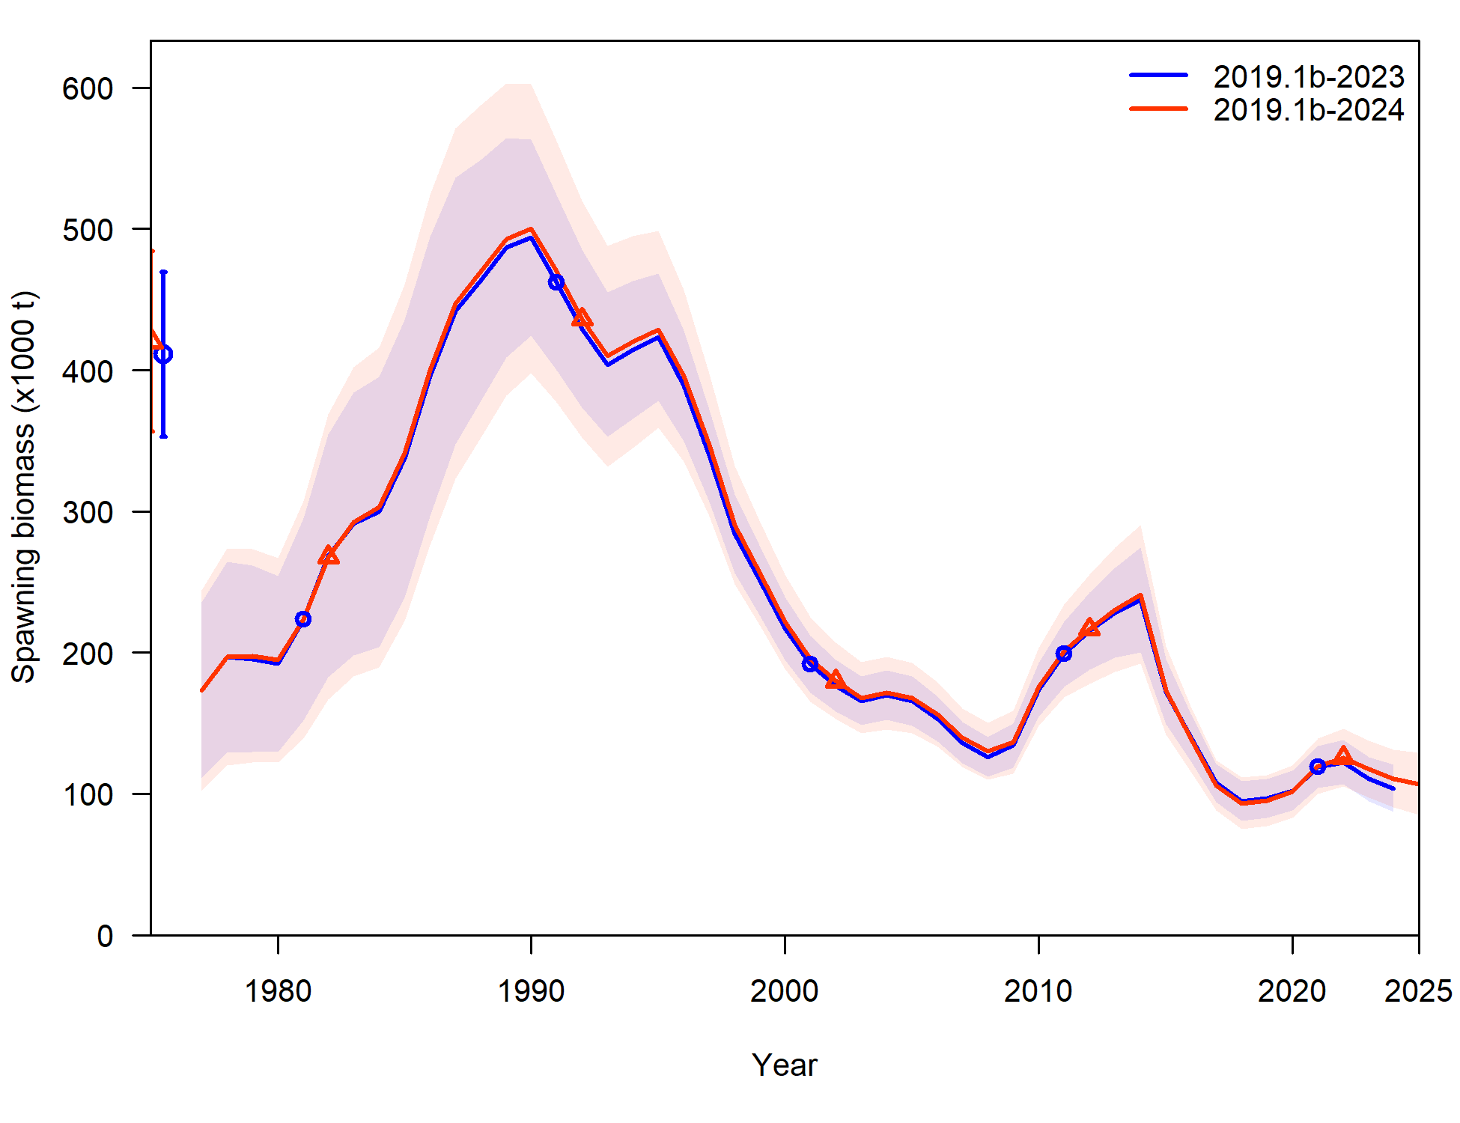
Base data updates (2019.1b-2024)
Trawl survey: GAP cleaned up old haul data, only includes specimen data associated with a haul that is used to compute abundance
Resulted in very minor differences in early trawl survey time series for abundance and comp data
Length-weight relationship continually updated

Slide 4
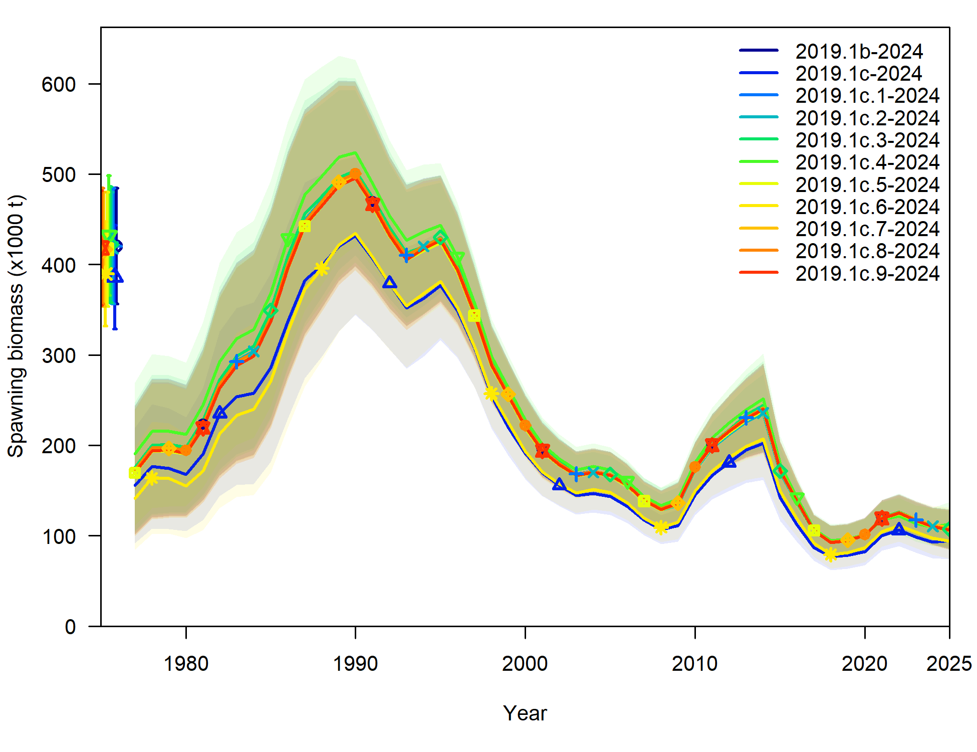
Input data file changes
9 changes recommended: denoted as 2019.1c.#
All added 1 at a time to model 2019.1b to evaluate sensitivity of model to each change individually

Slide 5
Input data file changes
LL survey:
Log-normal correction in RPN SD hadn’t been applied (but was applied to bottom trawl survey index), now is applied – 2019.1c.1
Length comps off by a cm (i.e., 25 cm fish became 26 cm) – 2019.1c.2
Length comps season had been set at 1 (Jan), when should have been set at 7 (Jul) – 2019.1c.3
Fishery length comps:
ISS set at total number of hauls sampled (max 200), but filtered hauls to a certain sample size in expansion (will talk more about filtering later), set at number of hauls actually used in expansion (max 200) – 2019.1c.4

Slide 6
Input data file changes
All length comps:
Set plus bin at 104 cm rather than 116 cm (<2% of years ꓯ data >0.01) – 2019.1c.5
Trawl survey conditional age-at-length
Season had been set at 1 (Jan), when should have been set at 7 (Jul) – 2019.1c.6
Consistency across assessments:
Turn off forecast recruitment params – 2019.1c.7

Slide 7
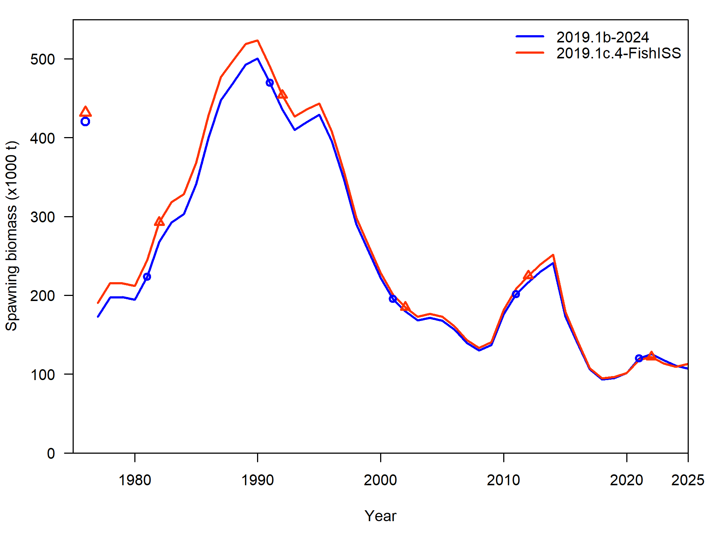
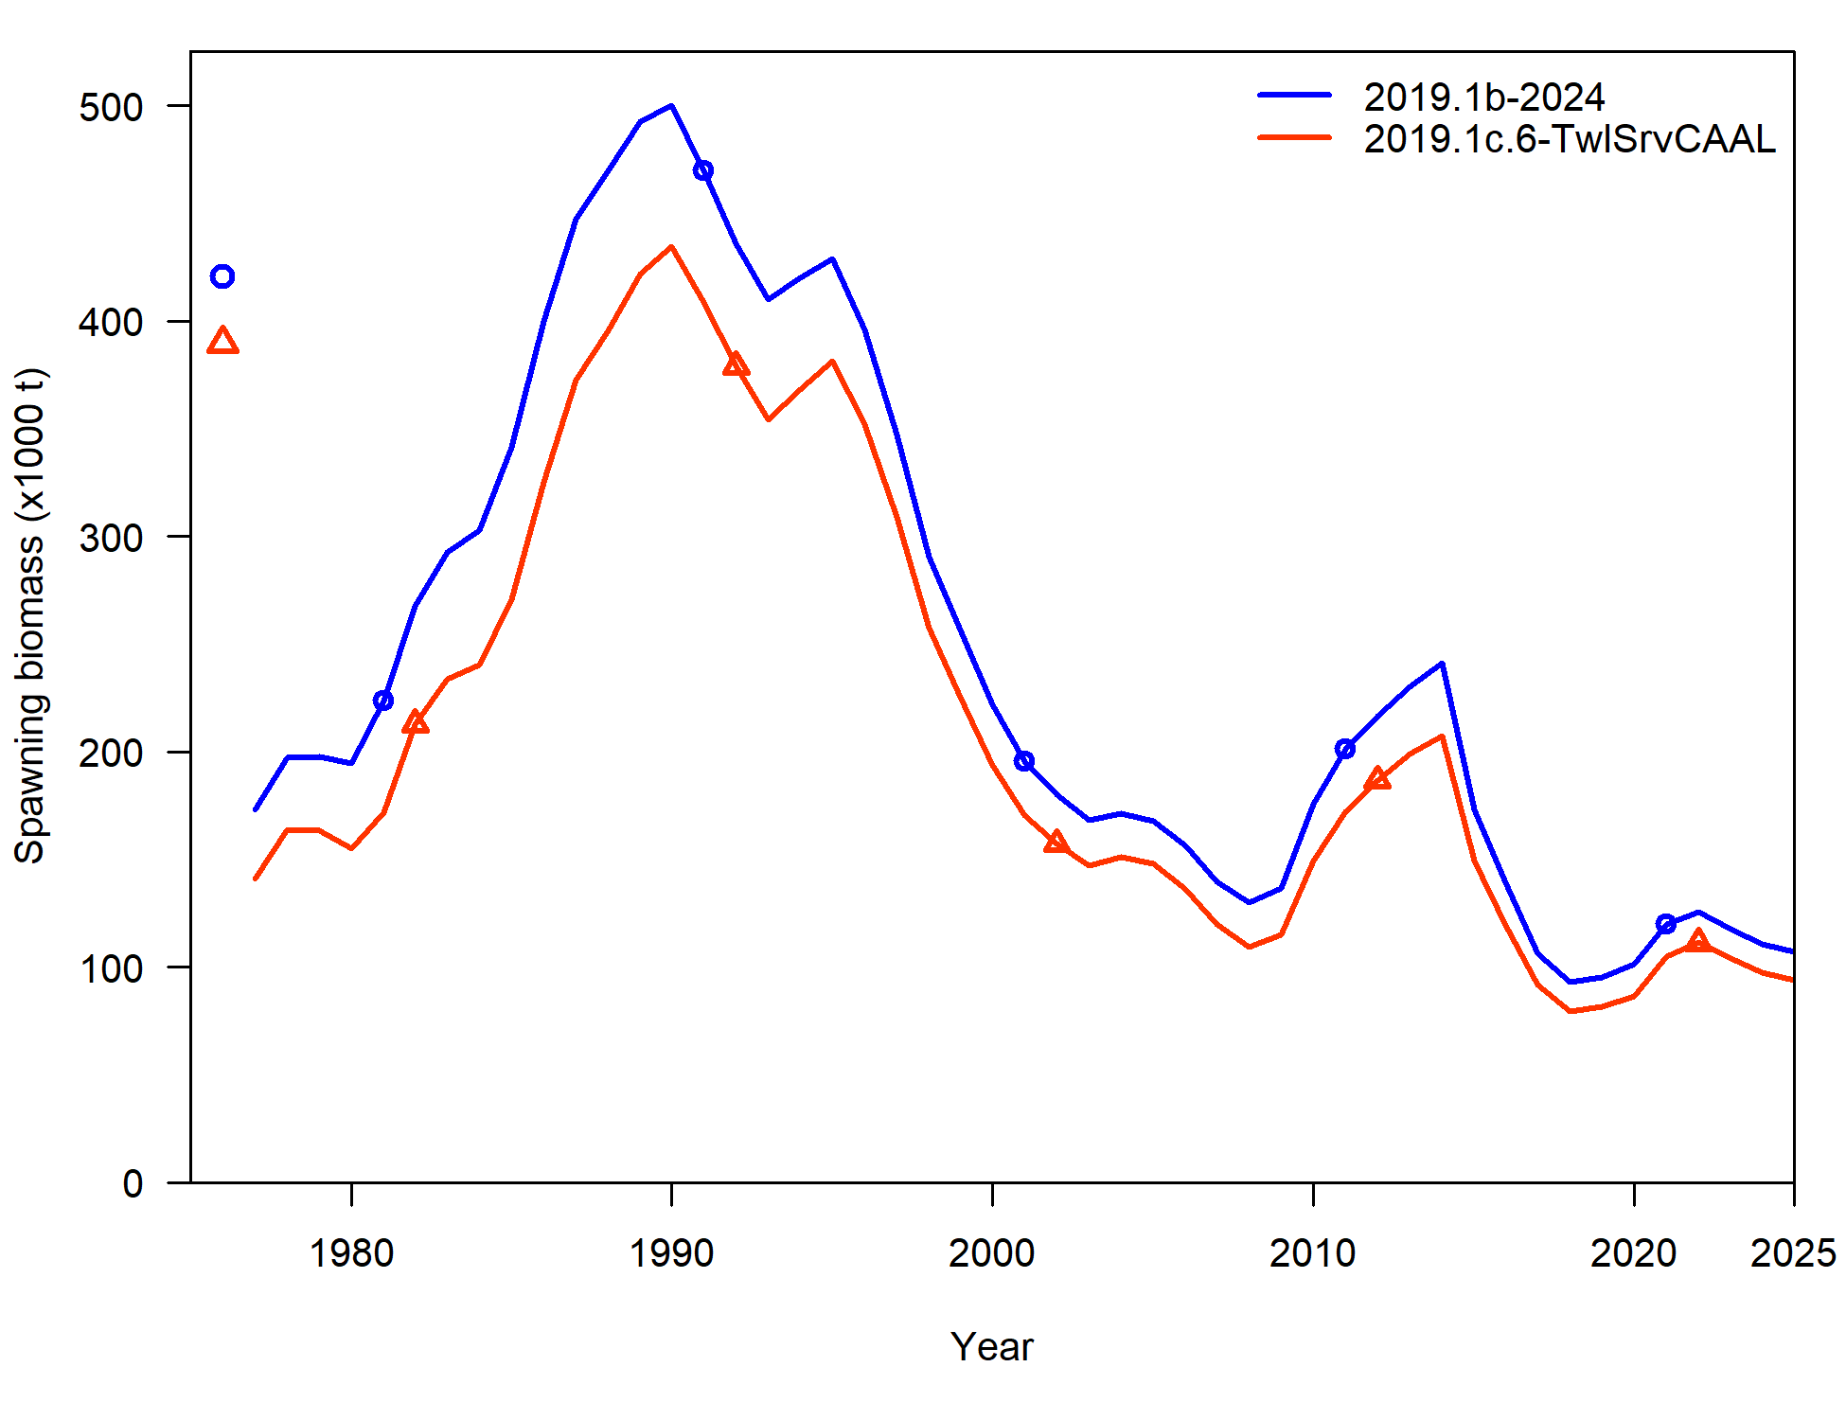
Input data file changes
Average % difference in SSB (from 2019.1b):
Model | %diff
2019.1c.1 | 0.02%
2019.1c.2 | -0.33%
2019.1c.3 | 0.82%
2019.1c.4 | 3.95%
2019.1c.5 | -1.17%
2019.1c.6 | -14.65%
2019.1c.7 | -0.18%
2019.1c.8 | 0.00%
2019.1c.9 | -0.86%

Slide 8
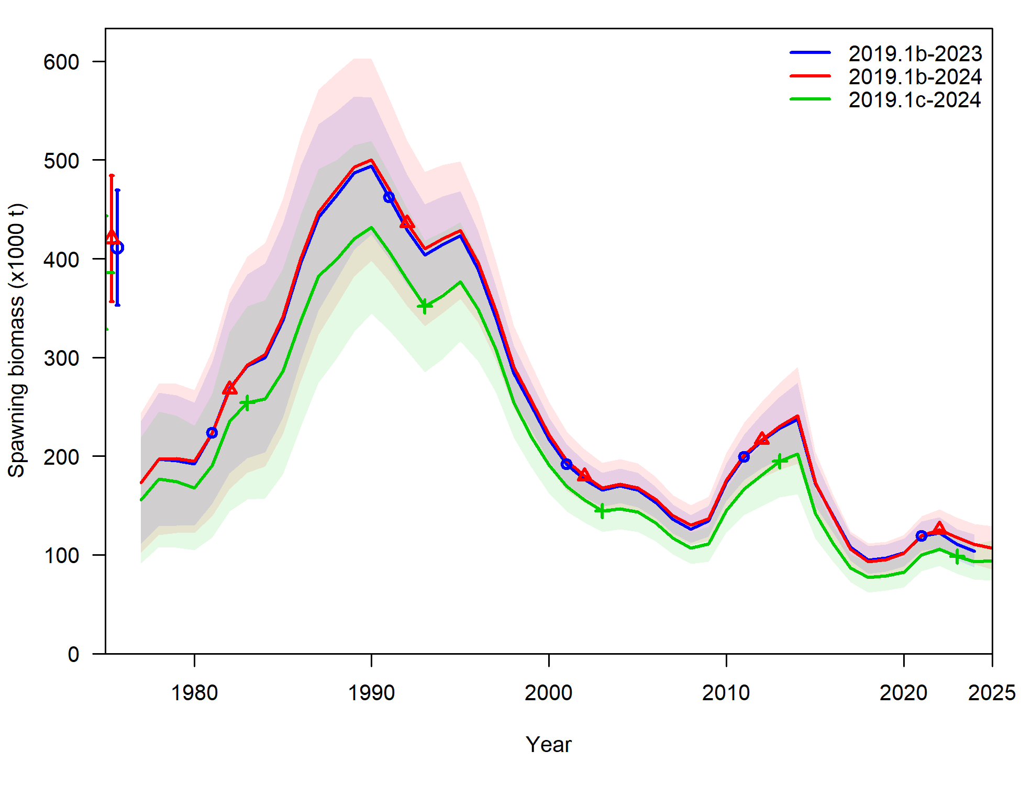
Input data file changes
Recommend input data changes
Corrects a number of mistakes
Increases consistency across models
Stabilizes parameter estimates
New model 2019.1c

Slide 9
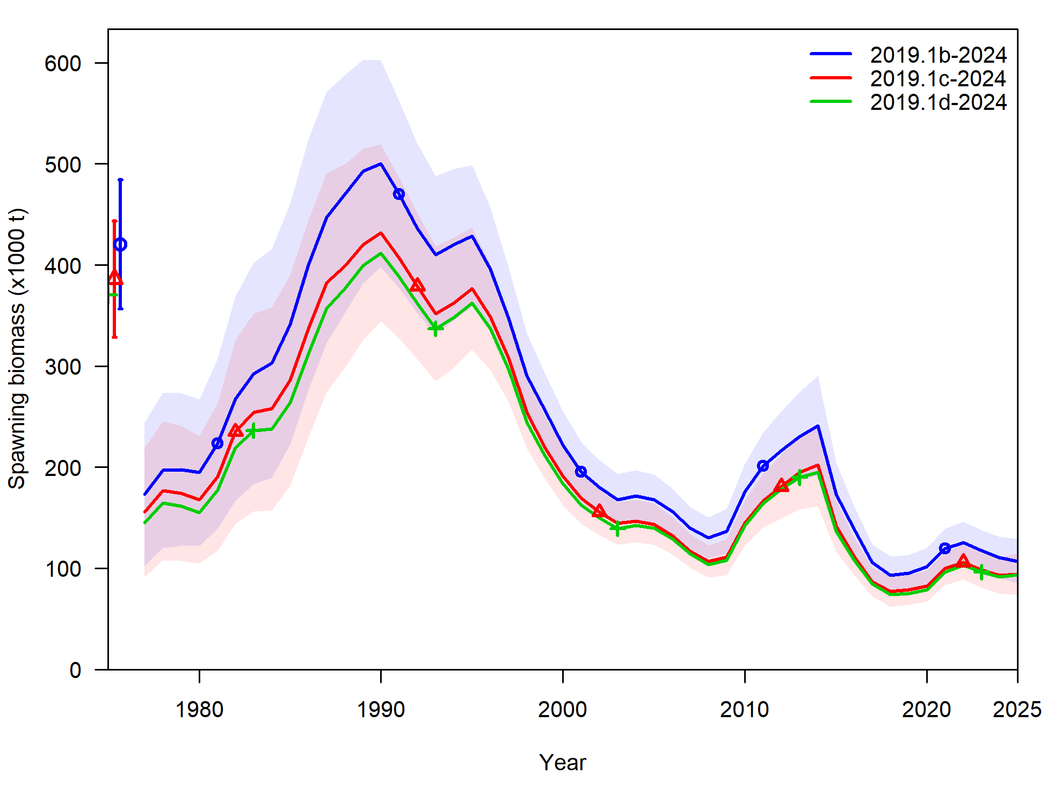
Recommended data updates (2019.1d)
Recommend updating ageing error:
Updated with new data (since 2017)
Old: start SD = 0.57, end SD = 1.16, started at age-3
New: start SD = 0.11, end SD = 1.09, start at age-1
Continue with linear and estimating bias pre-2007
New model: 2019.1d
Component | 2019.1c | 2019.1d
TOTAL | 2898.25 | 2788.53
Catch | 0.00 | 0.00
Survey | -6.60 | -7.97
Length comp | 1744.60 | 1743.23
CAAL | 1129.98 | 1023.00

Slide 10
Fishery length comp investigations
In process of code redevelopment, took time to evaluate fishery length comps
Reminder: have been having issue with recent data, particularly Pot fishery length comps
Will walk through how fishery length comps have been previously computed

Slide 11
Fishery length comp overview
2 expansion methods used in GOA Pcod assessment:
Pre-1991 (includes foreign data)
Post-1991 (domestic data only)
Pre-1991:
Computes weighted length frequencies at haul level for foreign and domestic separately (weighted by extrapolated number in haul)
Sums across foreign and domestic weighted length frequencies at year-gear level, standardizes

Slide 12
Fishery length comp overview
2 expansion methods used in GOA Pcod assessment:
Pre-1991 (includes foreign data)
Post-1991 (domestic data only)
Post-1991:
Computes weighted length frequency in a haul across area and gear within each week (weighted by extrapolated number in haul)
Sums weighted length frequency within hauls to week-area-gear level, weights by proportion of catch within each week-area-gear / catch by year-gear (catch in tons)
Sums to trimester-area-gear, fills in State data where there is no Federal data
Sums to year-gear, standardizes

Slide 13
Fishery length comp investigations: filtering
Post-91 data filtering: >10 per haul in fed data
Proportion of hauls removed:
 | Longline | Pot | Trawl
1991-2012 | 2% | 4% | 3%
2013 | 12% | 12% | 2%
2014 | 6% | 14% | 5%
2015 | 5% | 8% | 4%
2016 | 13% | 10% | 4%
2017 | 12% | 12% | 20%
2018 | 23% | 6% | 6%
2019 | 22% | 10% | 6%
2020 | 60% | -- | 79%
2021 | 20% | 14% | 72%
2022 | 6% | 30% | 76%
2023 | 34% | 36% | 68%

Slide 14
Fishery length comp investigations: State data
State data used to ‘fill-in’ missing federal observer data:
2 steps:
Step 1: filters state data to more than 30 lengths observed (at trimester-area-gear level) – very few filtered out, most for 90s trawl data
Step 2: uses state data if fed data missing for that trimester-area-gear combo
Step 2 | Longline | Pot | Trawl
1997-2016 | 65% | 81% | 62%
2017 | 67% | 100% | --
2018 | 60% | 67% | --
2019 | 60% | 50% | --
2020 | 0% | 0% | --
2021 | 33% | 33% | --
2022 | 40% | 100% | --
2023 | 50% | 0% | --

Slide 15
Fishery length comp investigations
Post-91 data filtering: >10 per haul in fed data
Propose: remove filter and include all data
State data used to ‘fill-in’ missing fed data
Propose: rather than ‘fill-in’, merge with fed data
Requires restructure of how fed length comp data computed as it’s expanded from week-area-gear level – that level of granularity not available in state data
Propose: simplify and expand from trimester-area-gear level rather than week-area-gear
Using 2019.1d as base model: 2019.1e

Slide 16
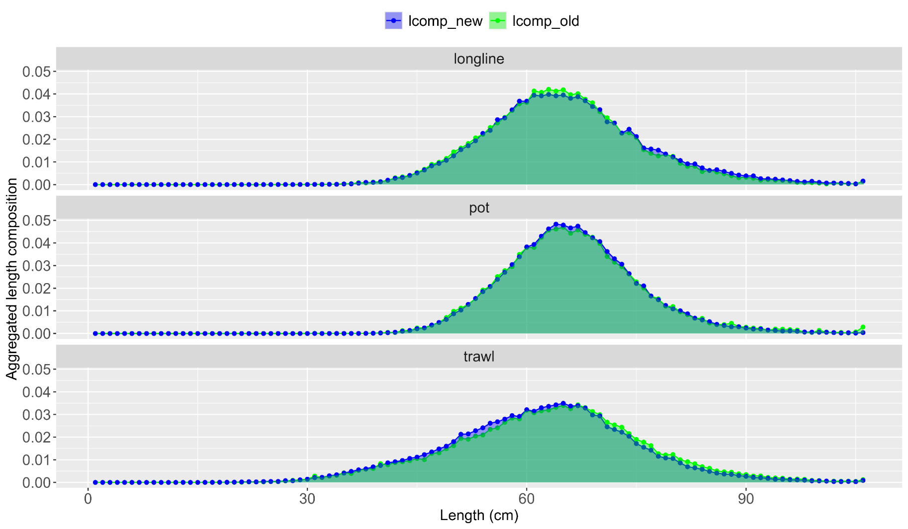
Fishery length comp investigations
Aggregated length comps:

Slide 17
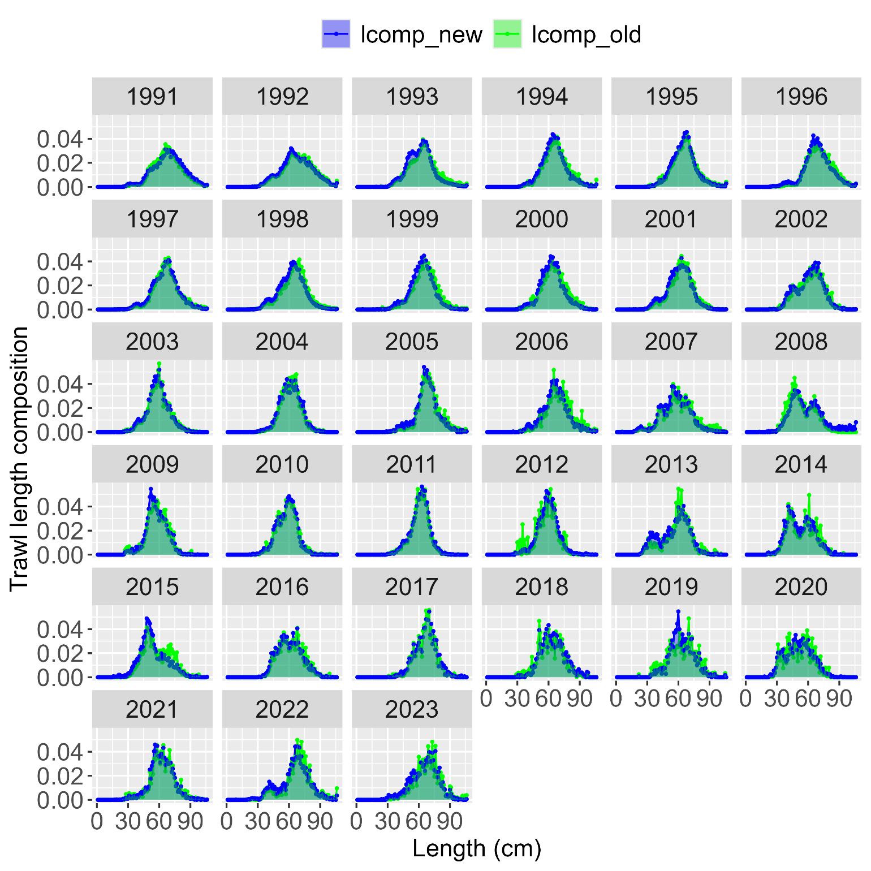
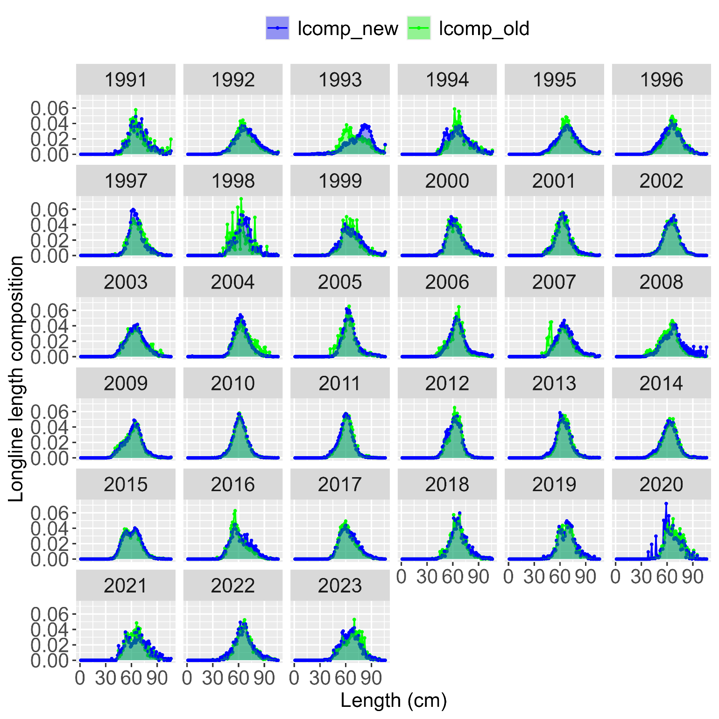

Slide 18
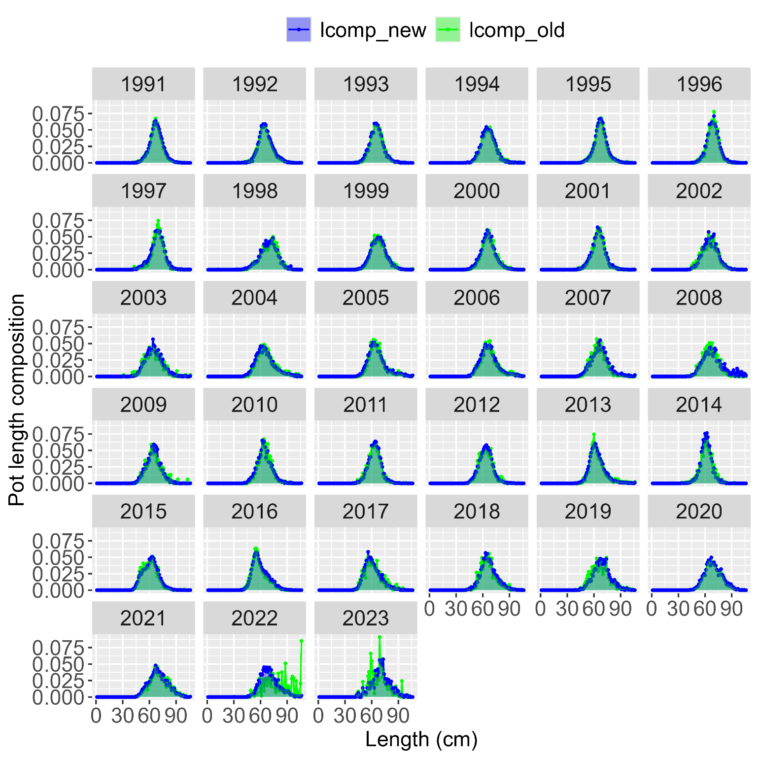

Slide 19
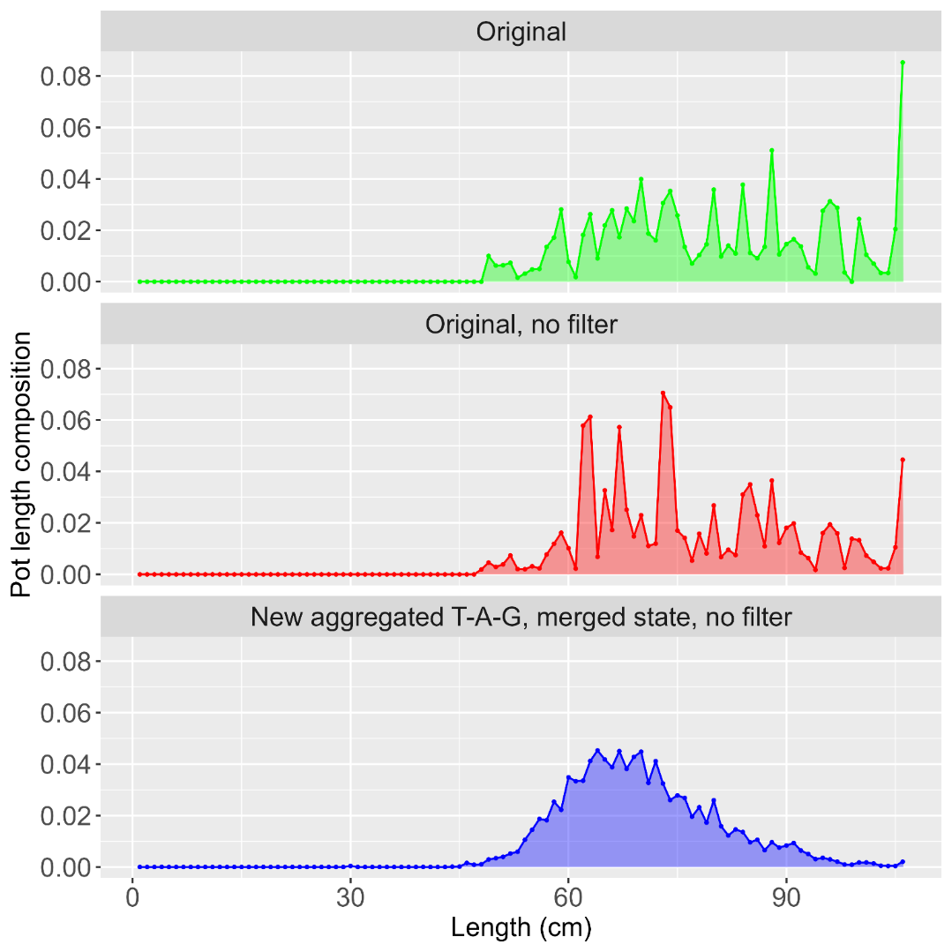
37 hauls
n = 698
No state
53 hauls
n = 794
No state
n = 6417
With state

Slide 20
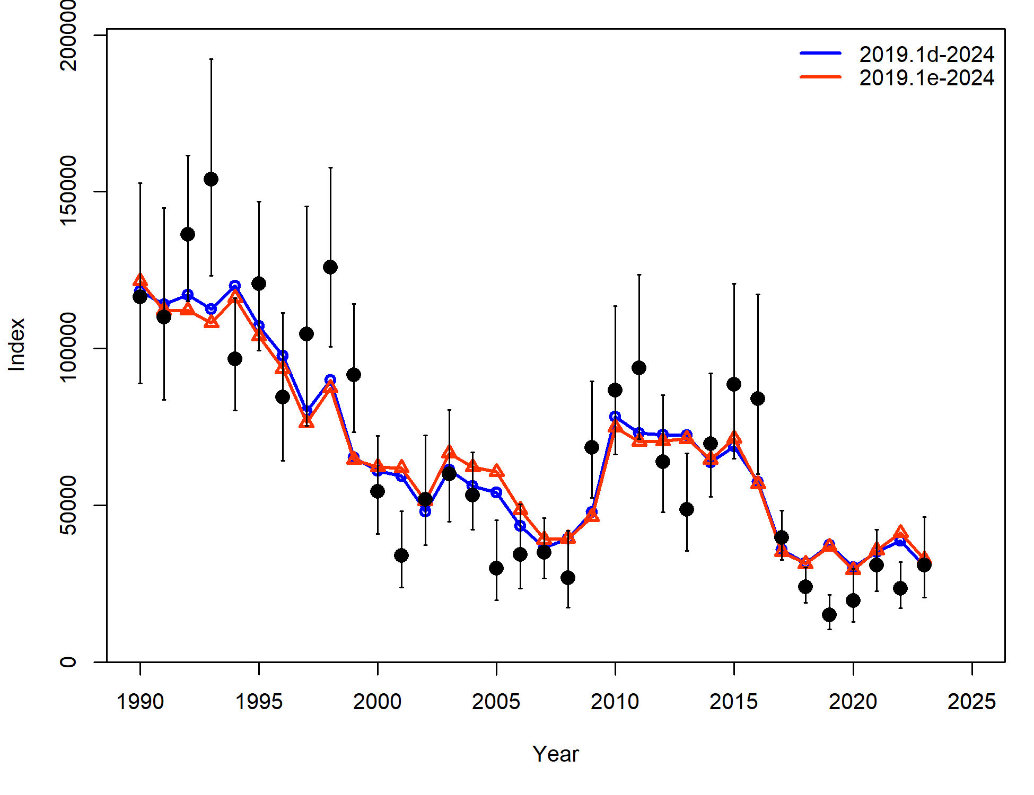
Fishery length comp investigations
Overall, removing filters, aggregating at trimester-area-gear level and merging state data helps to smooth out much of the variability in fishery length comps
Component | 2019.1d | 2019.1e
TOTAL | 2788.53 | 2754.05
Catch | 0.00 | 0.00
Survey | -7.97 | 3.12
Length_comp | 1743.23 | 1693.33
Age_comp | 1023.00 | 1030.66
Recruitment | 4.10 | -0.93
InitEQ_Regime | 3.60 | 3.35
Parm_priors | 16.58 | 18.62
Parm_softbounds | 0.02 | 0.02
Parm_devs | 5.97 | 5.87
 | 2019.1d | 2019.1e
ALL | -7.97 | 3.12
Srv | -8.90 | -7.25
LLSrv | 0.93 | 10.37

Slide 21
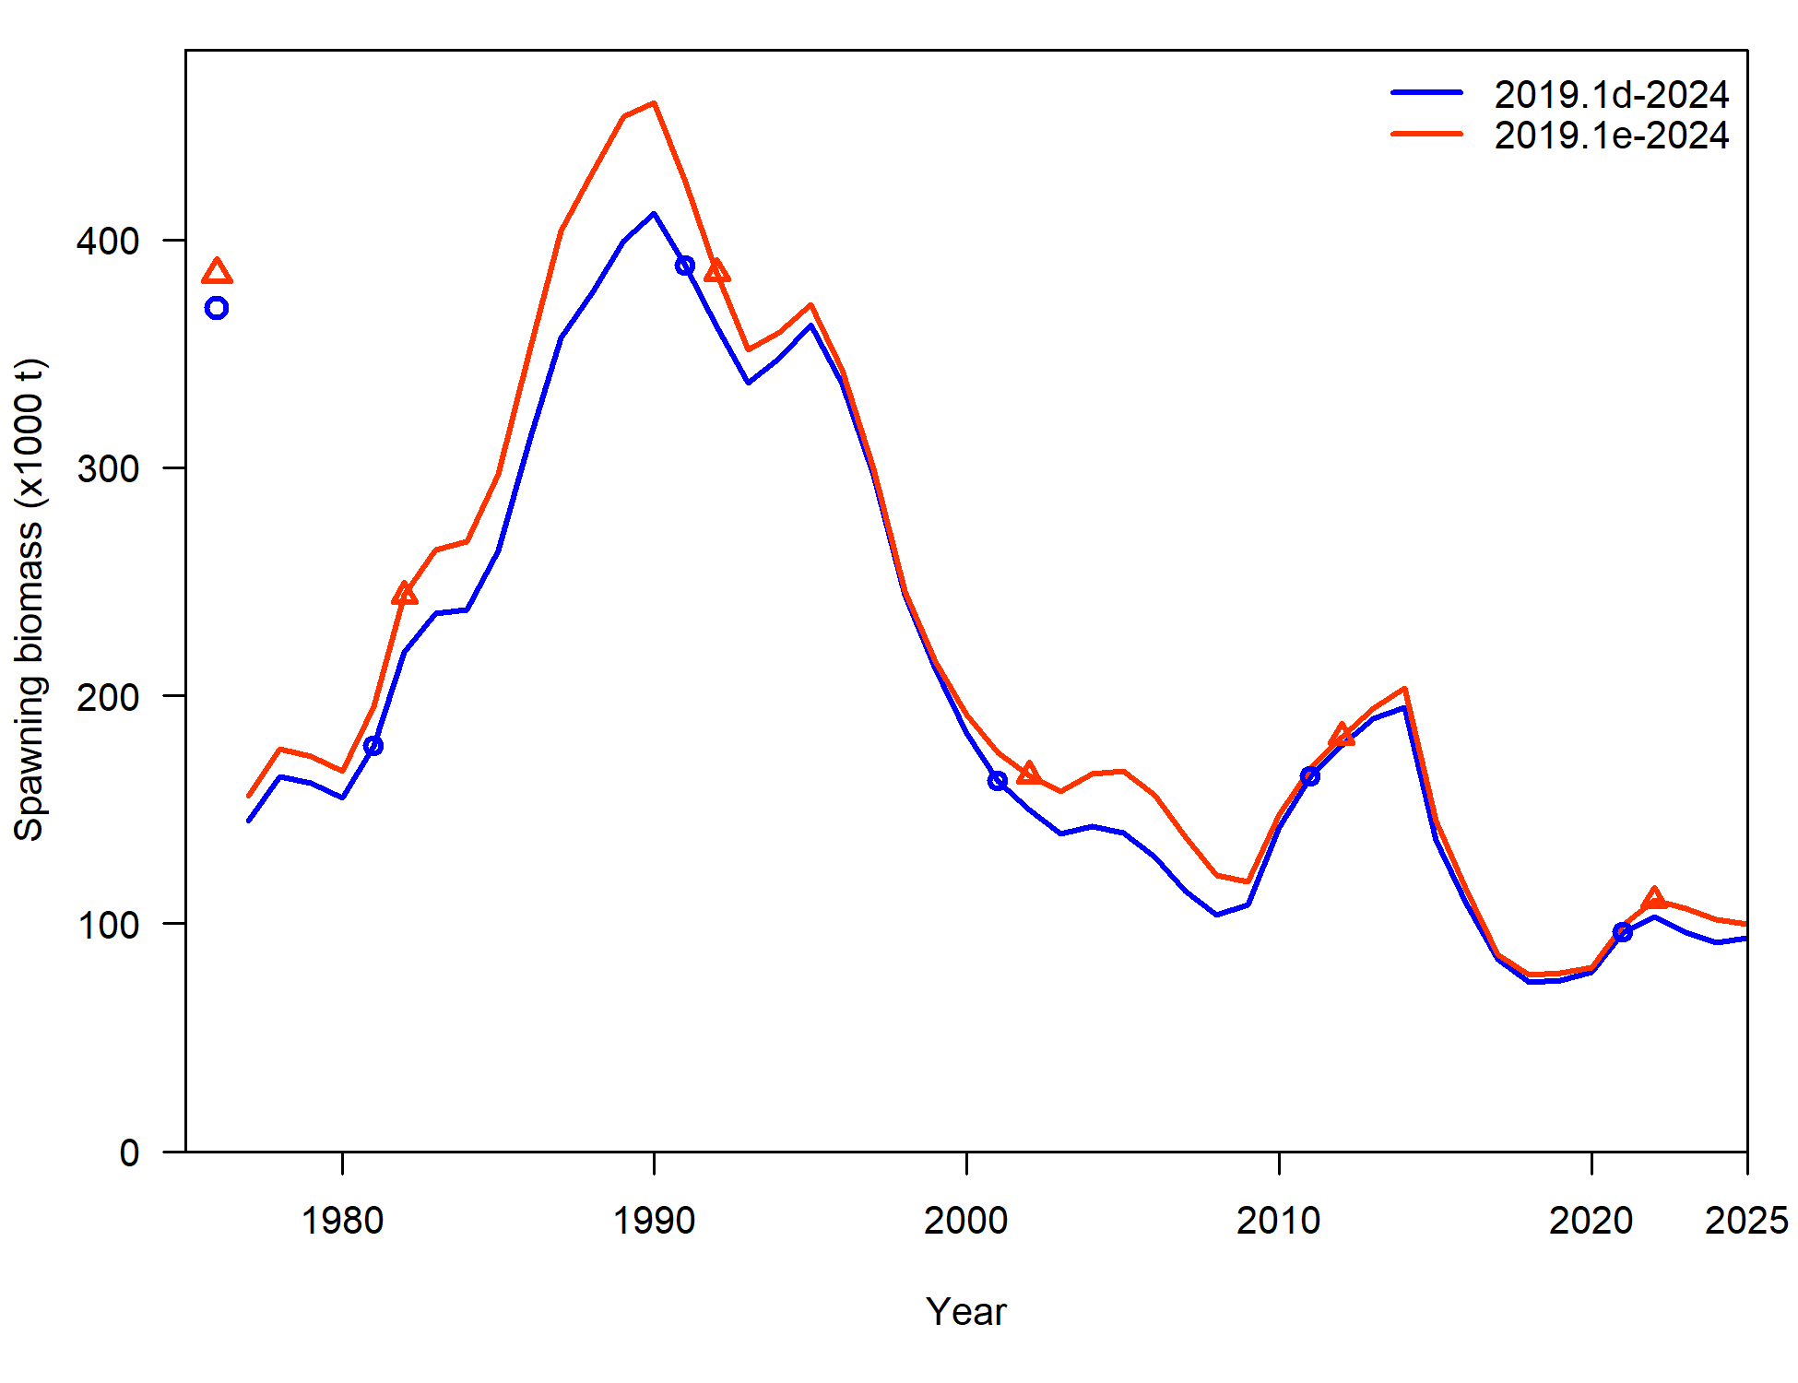
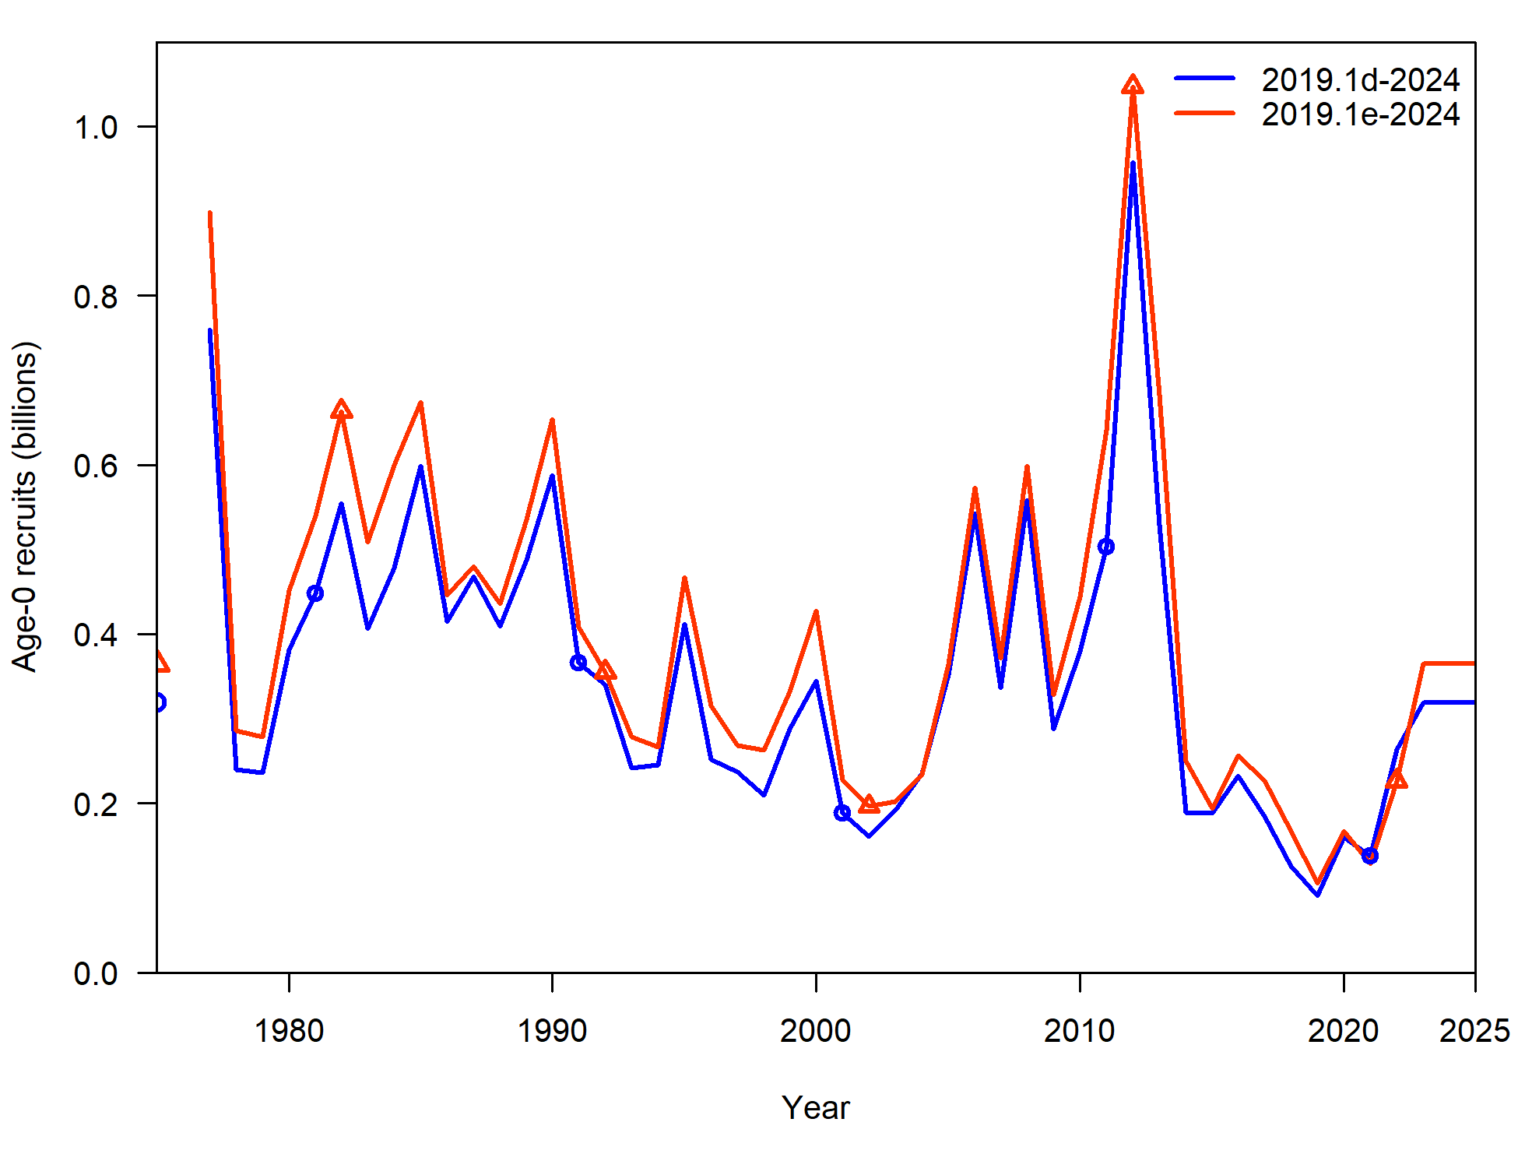
Fishery length comp investigations
Overall, removing filters, aggregating at trimester-area-gear level and merging state data helps to smooth out much of the variability in fishery length comps

Slide 22
Fishery length comp investigations
Overall, there are some differences in model estimates
In order to remove variability in fishery length comps and leverage information contained within State length sampling data, Recommend new model 2019.1e

Slide 23
Fishery length comp investigations
But, only gets us so far
Propose: align with EBS cod investigations this year, and investigate binning length data
2 cm bins – 2019.1e.2cm
5 cm bins – 2019.1e.5cm
Affects: all length comp (surveys & fishery) and conditional age-at-length (trawl survey and fishery)

Slide 24
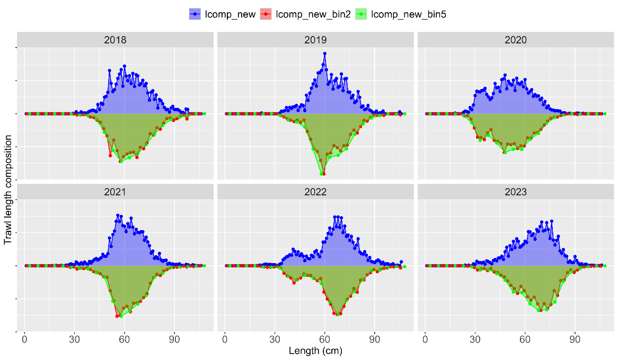
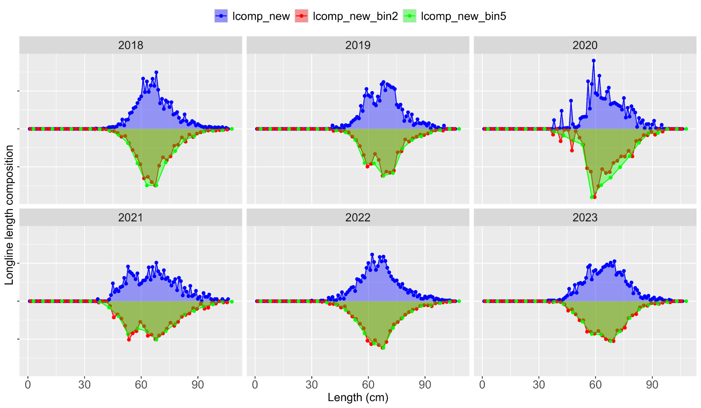
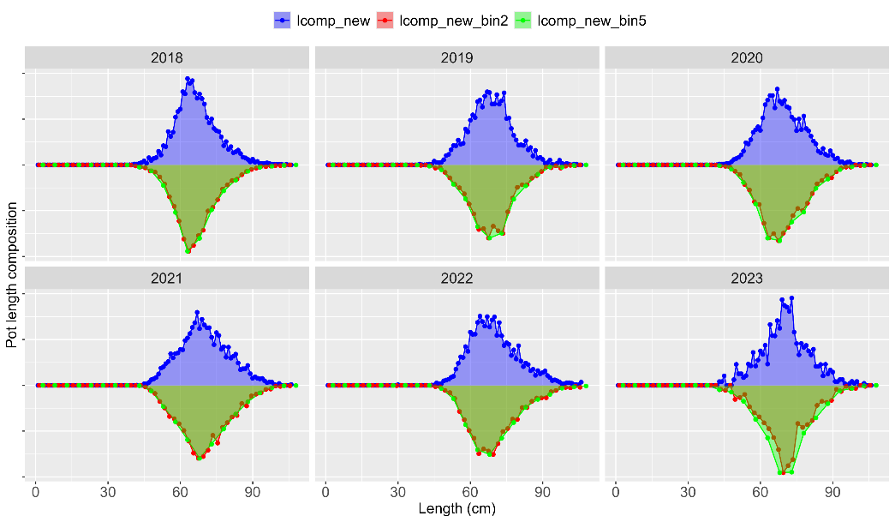
Length comp binning: fishery

Slide 25
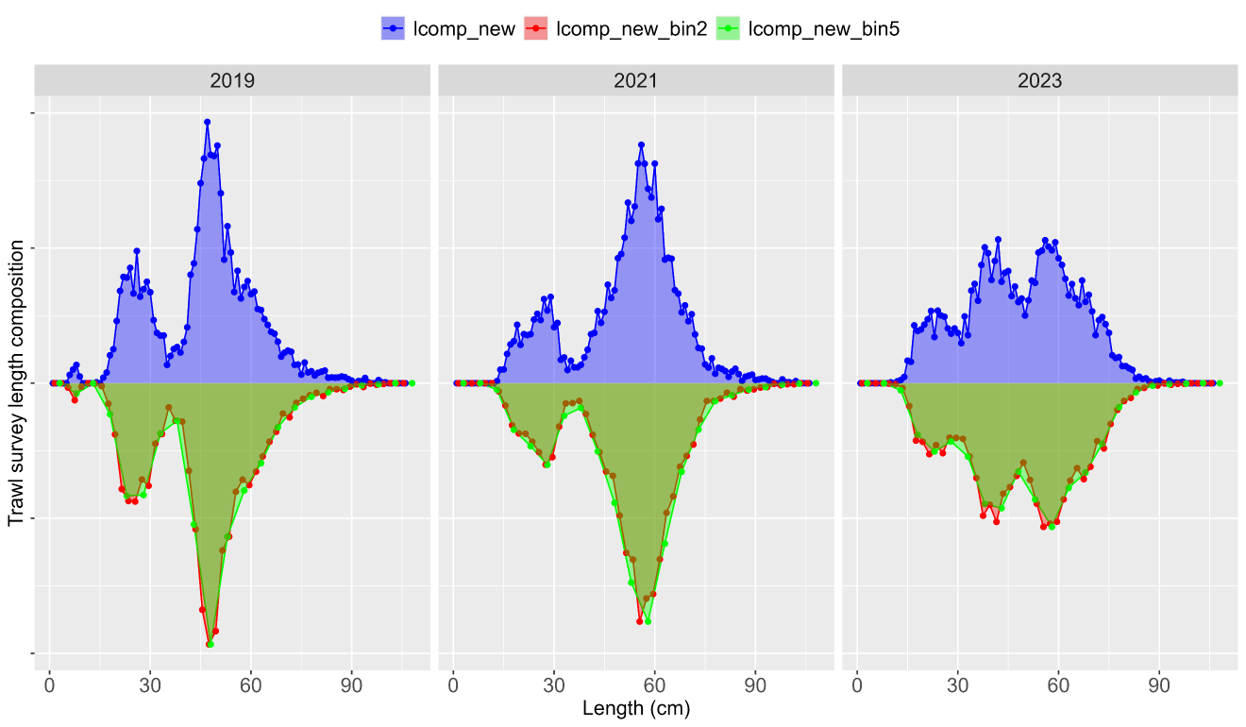
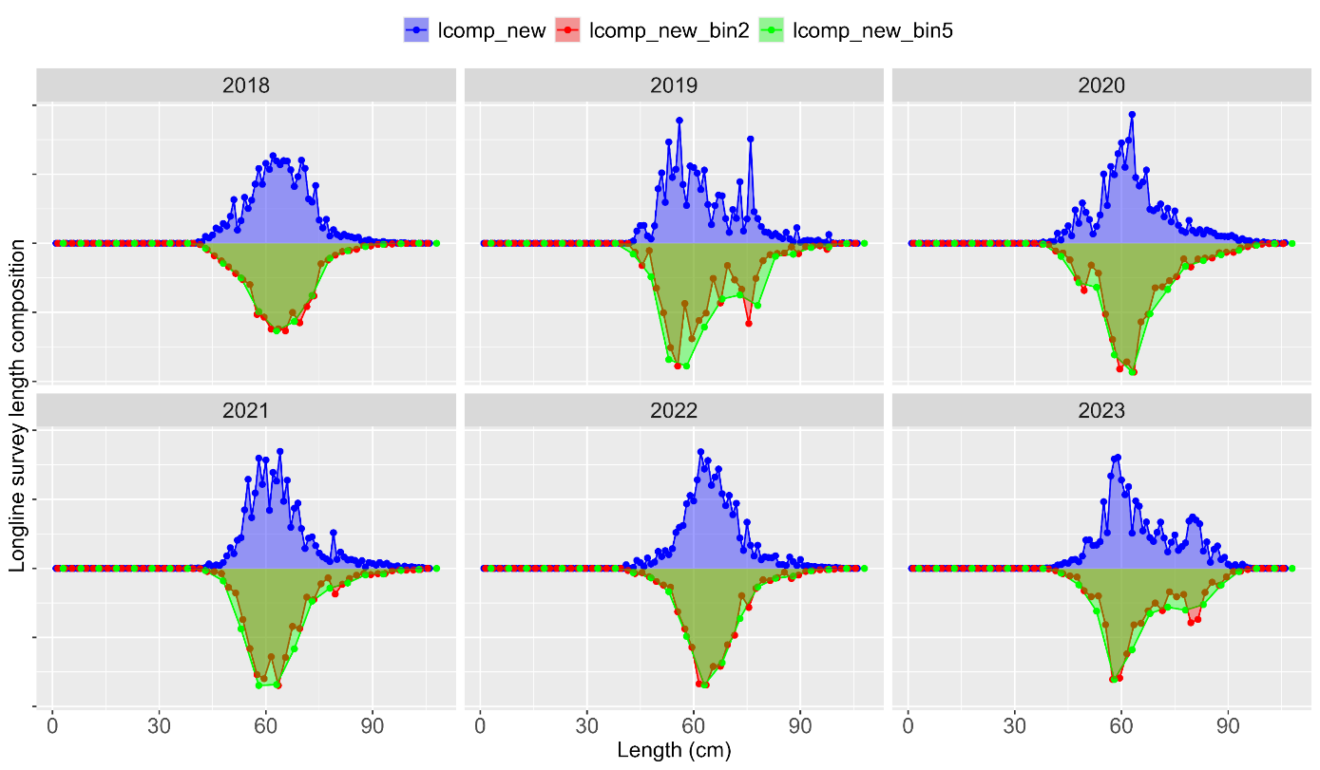
Length comp binning: survey

Slide 26
Length comp binning
In data:
Overall, removing filters, aggregating at trimester-area-gear level and merging state data helps to smooth out much of the variability in fishery length comps
And, binning to 5 cm removes variability in length composition without loosing important signal

Slide 27
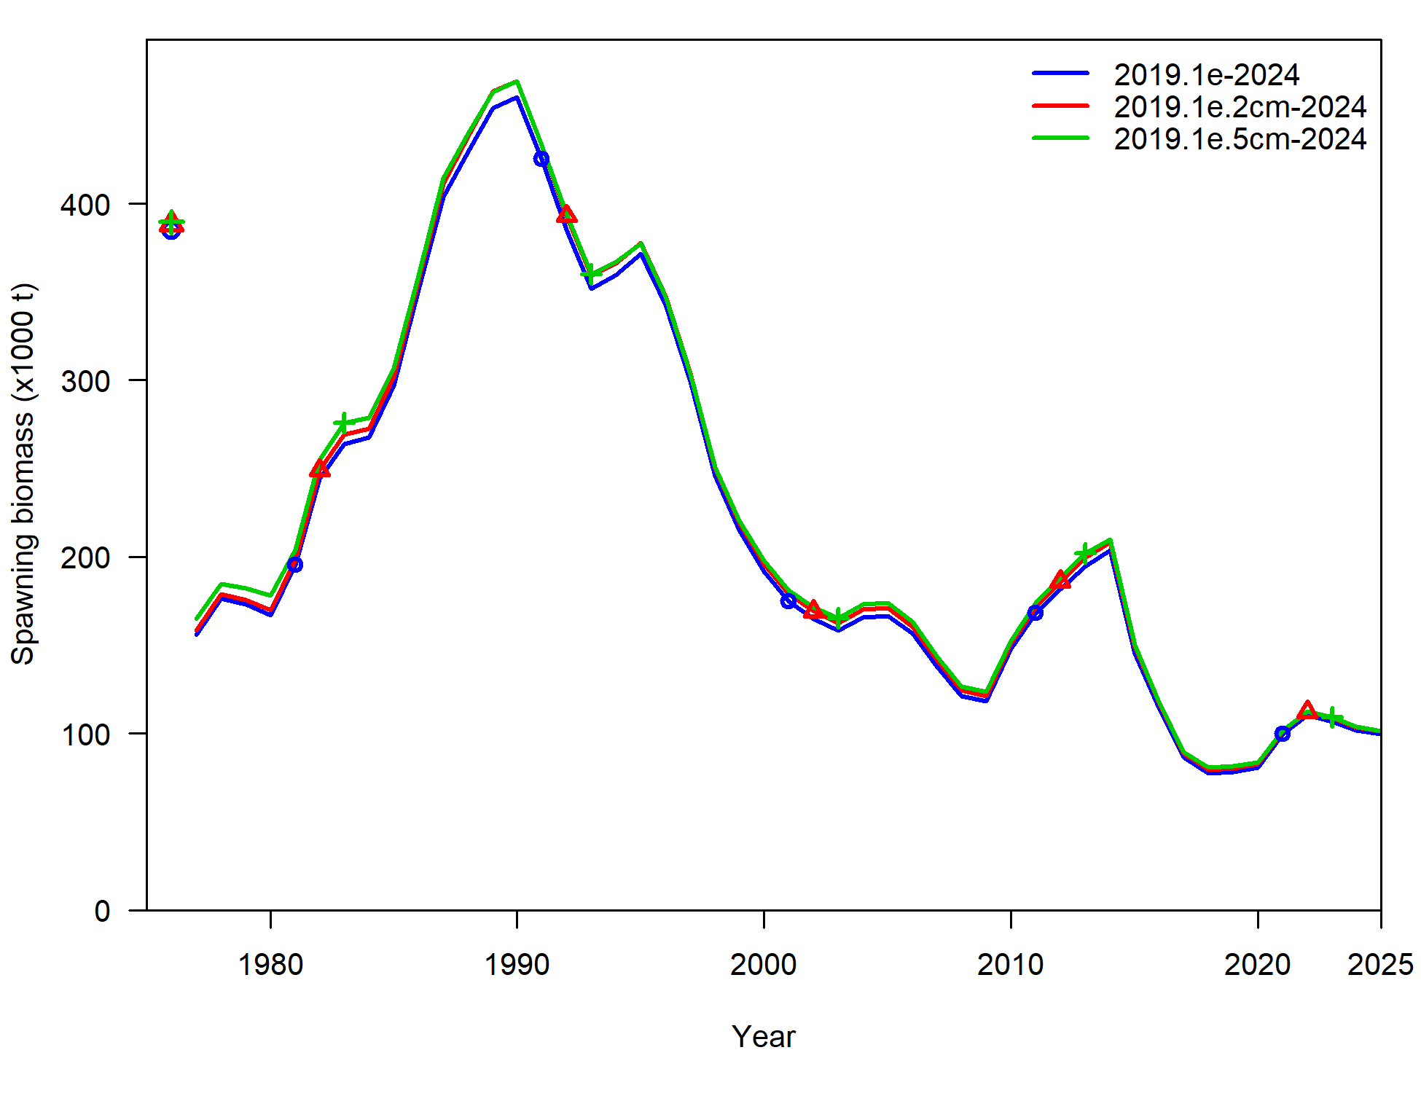
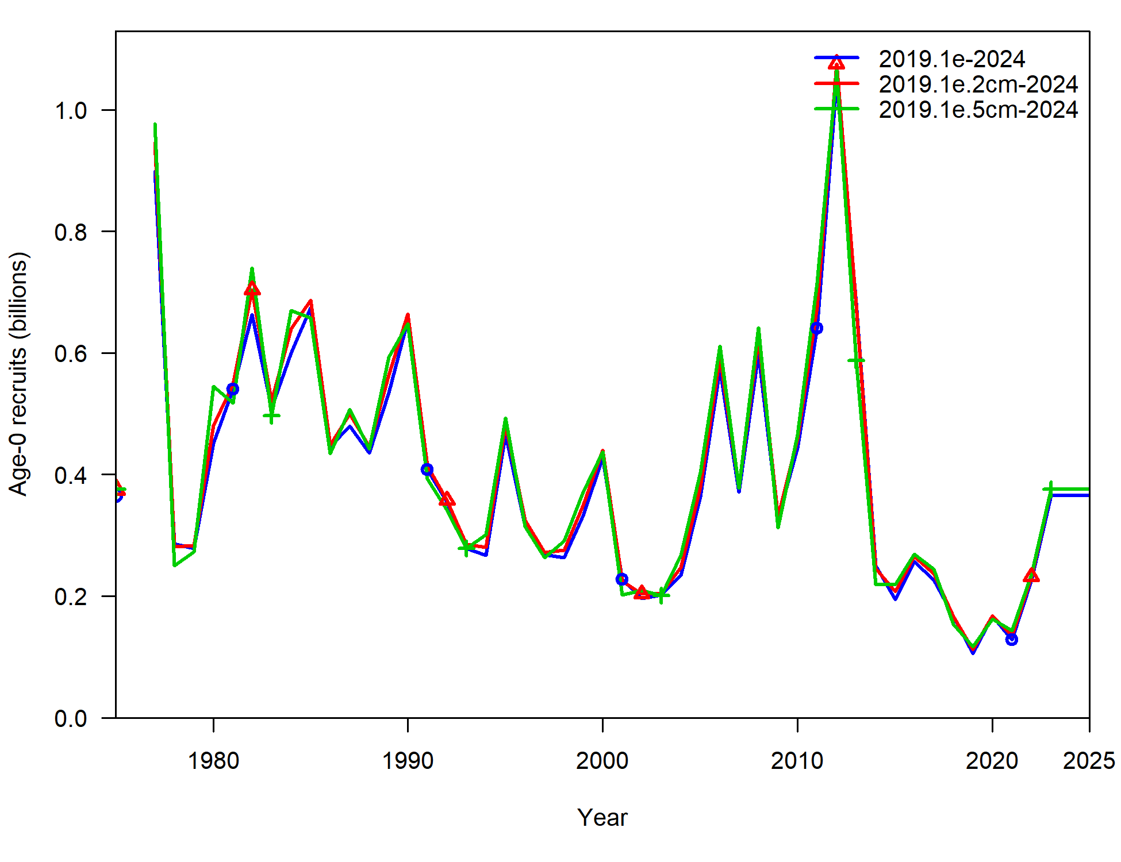
Length comp binning
In model:
Component | 2019.1e | 2019.1e.2cm | 2019.1e.5cm
TOTAL | 2754.05 | 2390.89 | 2029.67
Catch | 0.00 | 0.00 | 0.00
Survey | 3.12 | 4.10 | 5.11
Length_comp | 1693.33 | 1531.21 | 1349.22
Age_comp | 1030.66 | 827.92 | 649.13
Recruitment | -0.93 | -0.51 | 0.77
InitEQ_Regime | 3.35 | 3.26 | 2.84
Parm_priors | 18.62 | 19.12 | 17.03
Parm_softbounds | 0.02 | 0.02 | 0.02
Parm_devs | 5.87 | 5.77 | 5.55

Slide 28
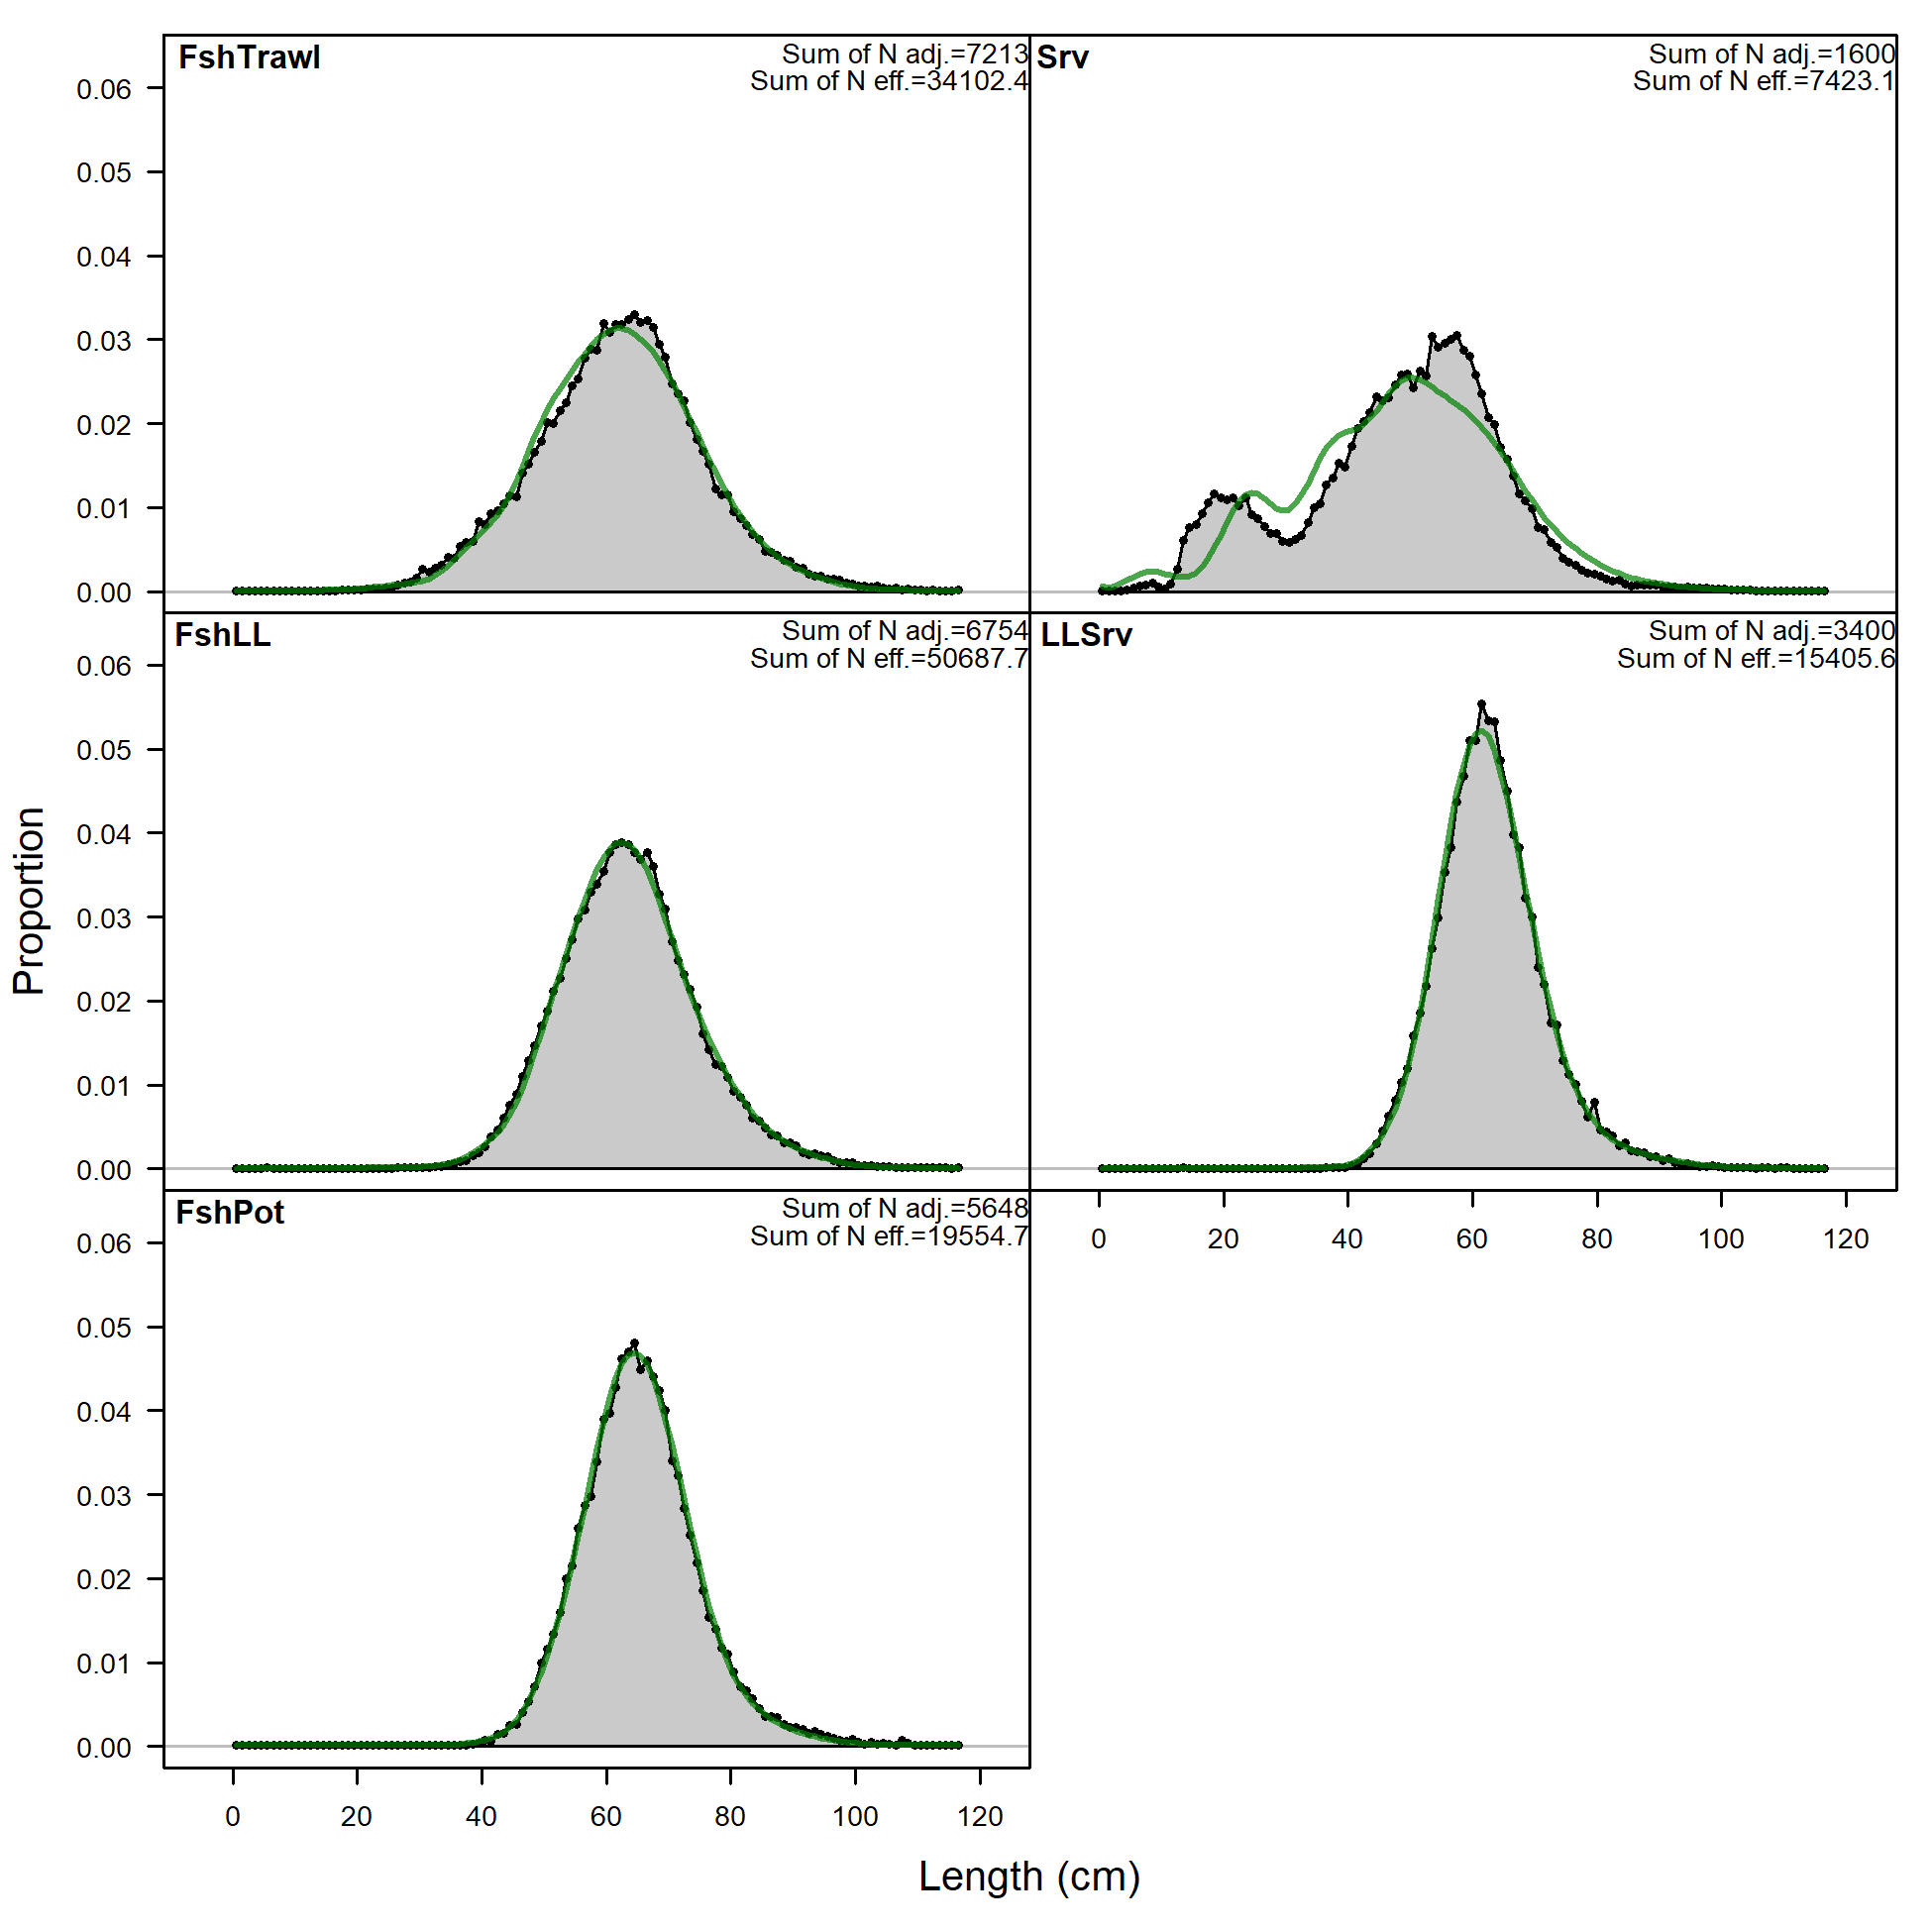
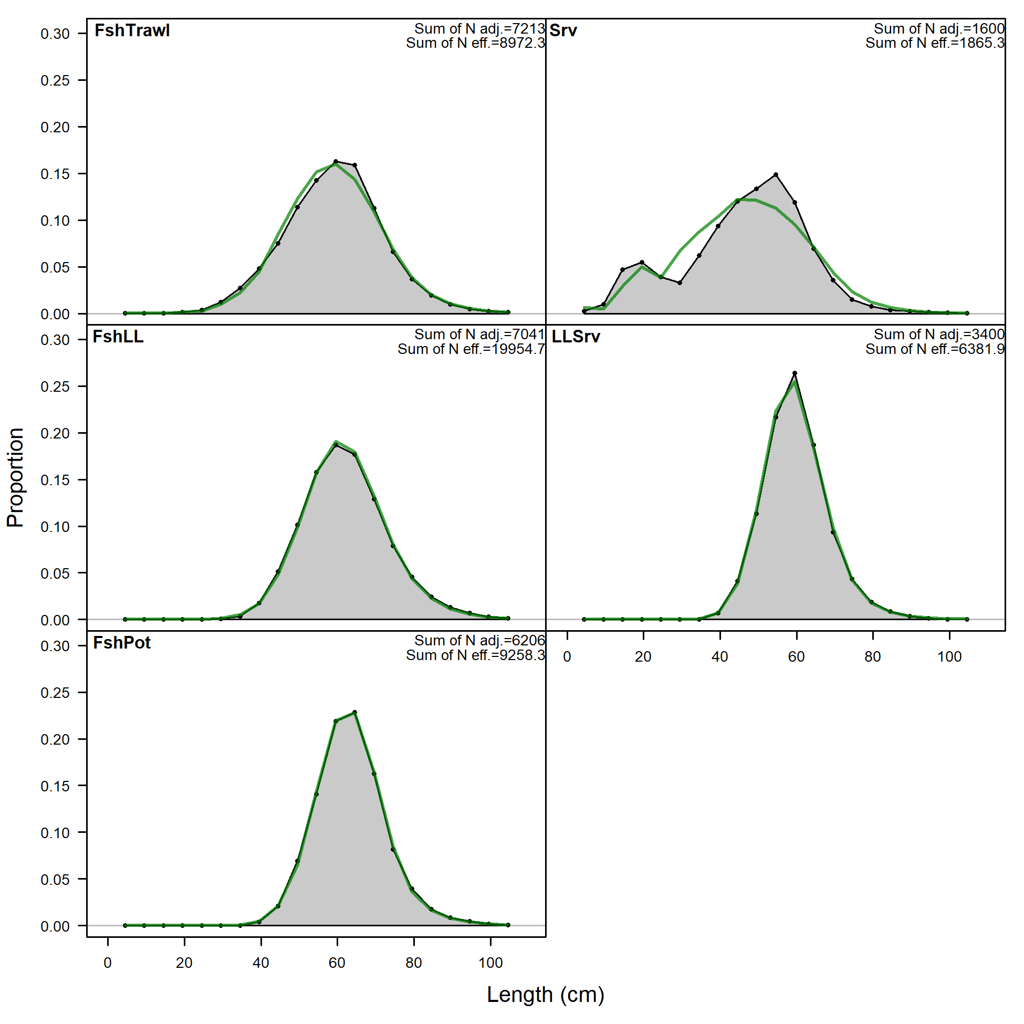
Length comp binning
Model robust to changes in length comp binning
To increase model efficiency Recommend new model 2019.1e.5cm
2019.1b
2019.1e.5cm

Slide 29
Maturity
Recent tagging studies have provided potential information to update maturity ogive in assessment
Currently assessment uses maturity as estimated from the sizeMat R package using data from Stark (2007)
In process of comparing new information from recent tagging studies to what’s used in assessment, discovered a transcription error: in SAFE L_{50%} = 57.3 cm, in model ctl file L_{50%} = 53.7 cm

Slide 30
Maturity
In process of comparing new information from recent tagging studies to what’s used in assessment, discovered a transcription error: in SAFE L_{50%} = 57.3 cm, in model ctl file L_{50%} = 53.7 cm

Slide 31
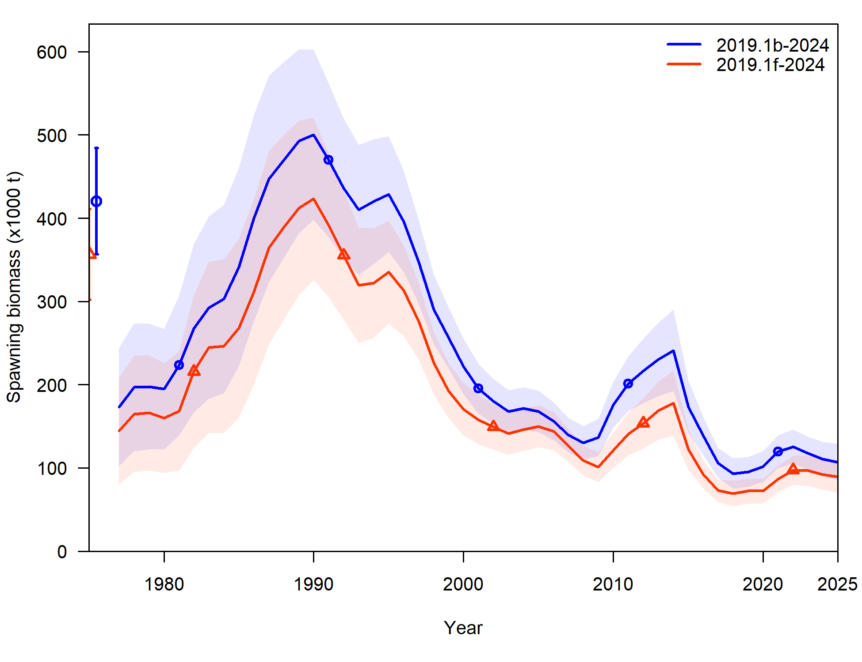
Maturity
Use model 2019.1e.5cm and correct transcription error, new model: 2019.1f

Slide 32
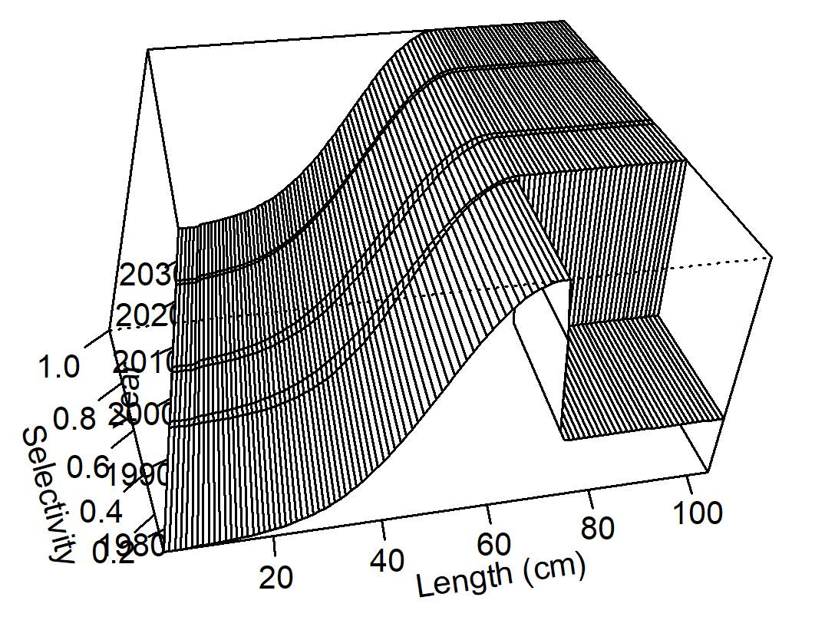
Trawl survey selectivity
In process of input data changes: descending width for trawl survey selectivity approaching 0 for <= 1996 block
2 years of survey index/length/CAAL data
Investigate time-invariant, asymptotic, trawl survey selectivity
Set parameter initial values (and whether estimated or not) to what is used in most recent time block
New model: 2024.0

Slide 33
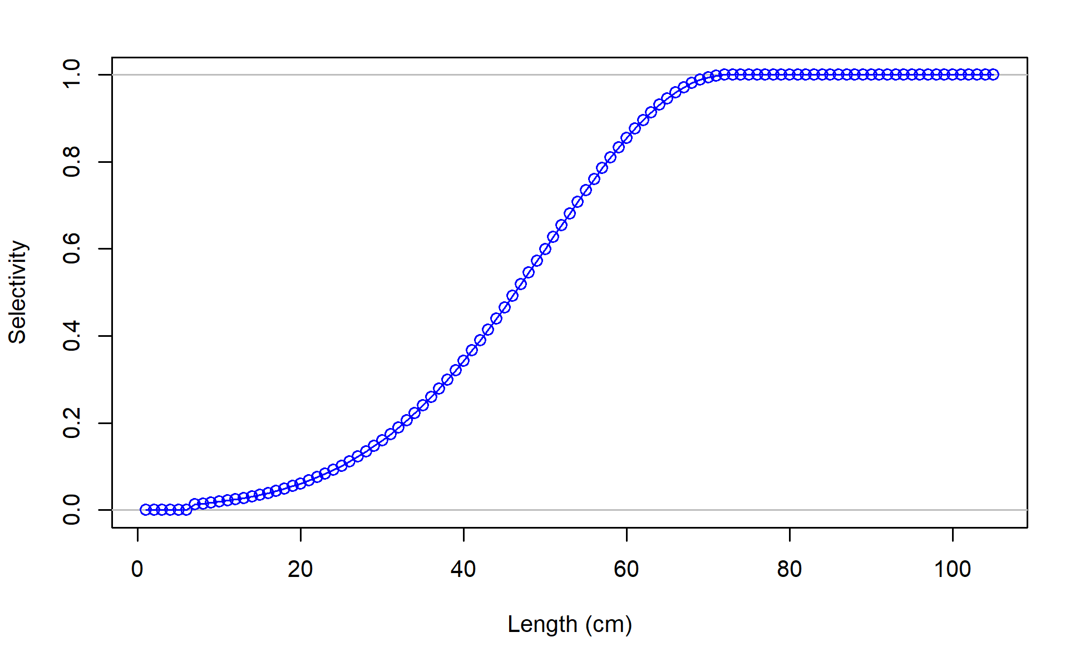
Trawl survey selectivity
New model: 2024.0
Component | 2019.1f | 2024.0
TOTAL | 2029.67 | 2041.08
Catch | 0.00 | 0.00
Survey | 5.11 | 10.13
Length_comp | 1349.22 | 1357.23
Age_comp | 649.13 | 648.78
Recruitment | 0.77 | -0.26
InitEQ_Regime | 2.84 | 2.84
Parm_priors | 17.03 | 16.82
Parm_softbounds | 0.02 | 0.01
Parm_devs | 5.55 | 5.53
 | 2019.1f | 2024.0
TOTAL | 2029.67 | 2041.08
# params | 193 | 184
AIC | 4445.34 | 4450.16
ΔAIC | 0 | 4.82

Slide 34
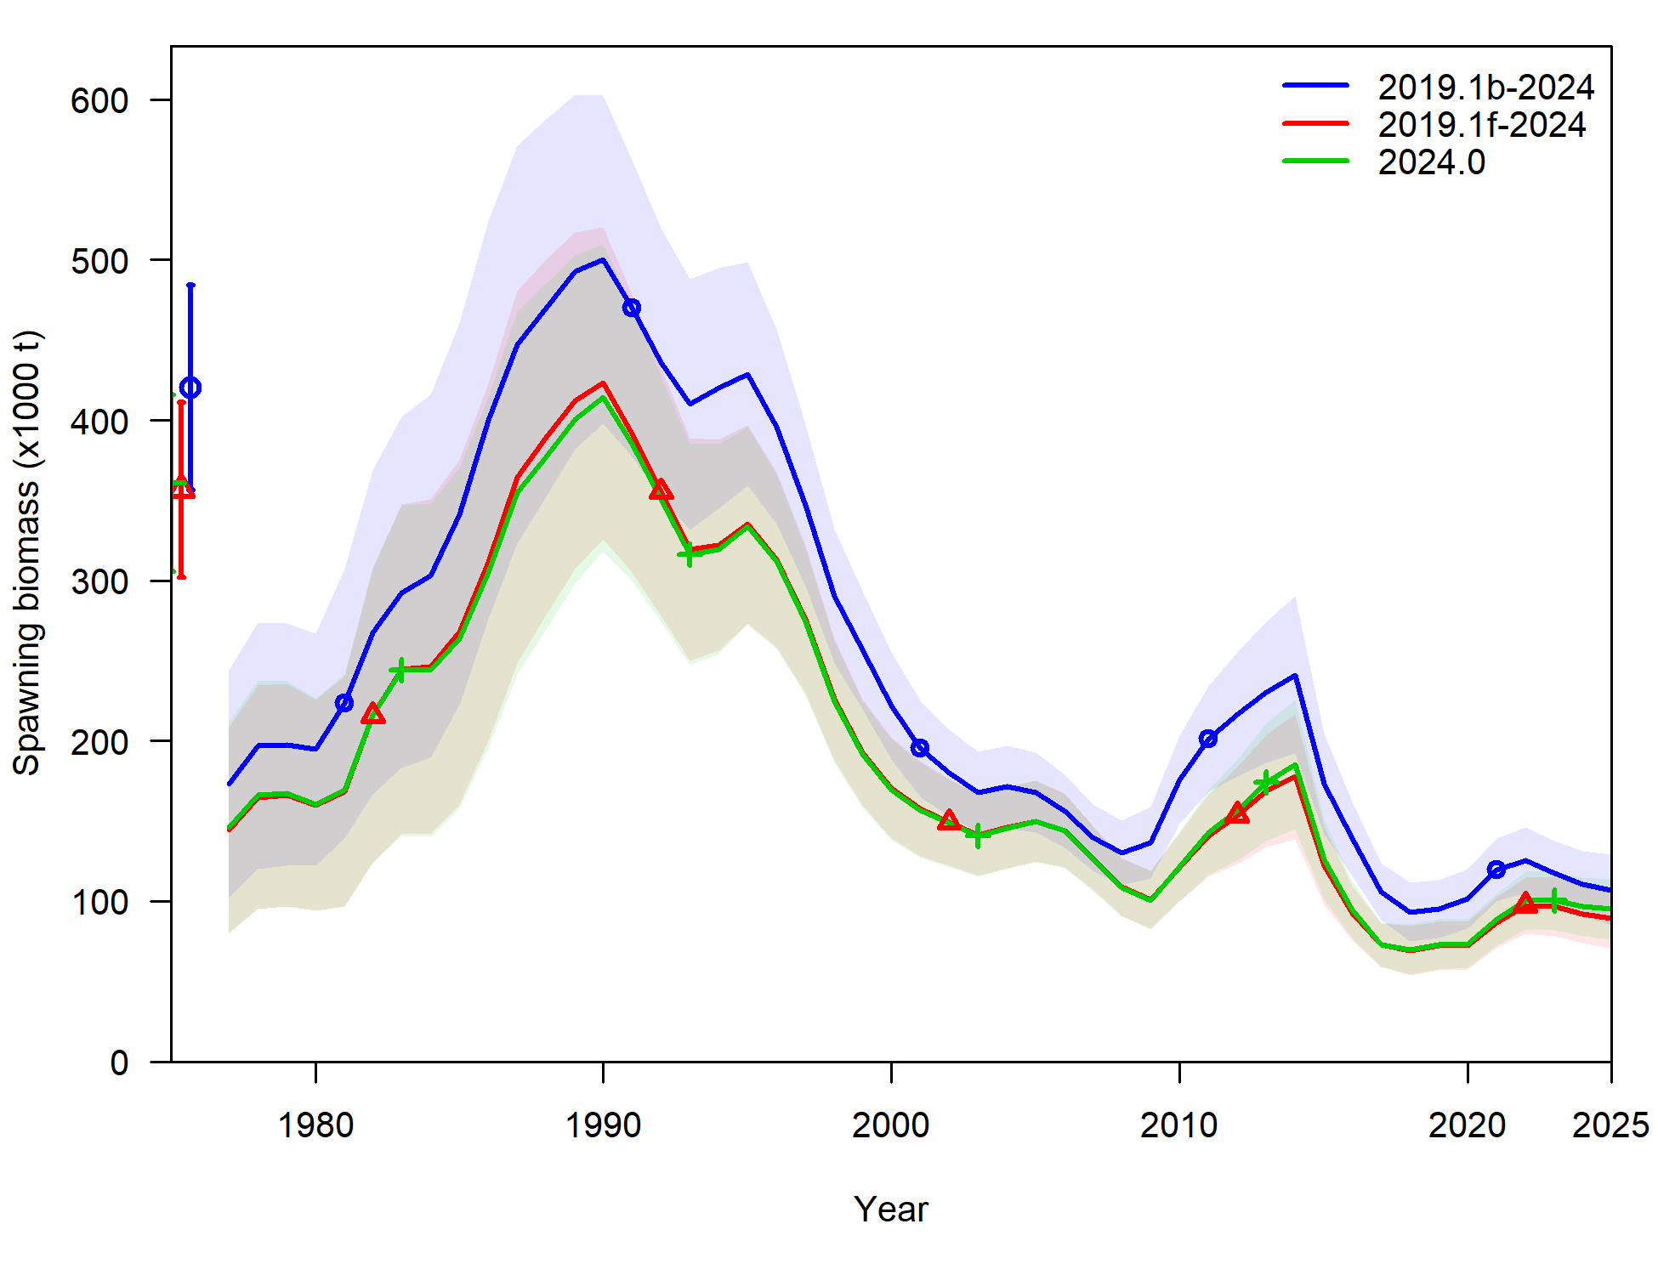
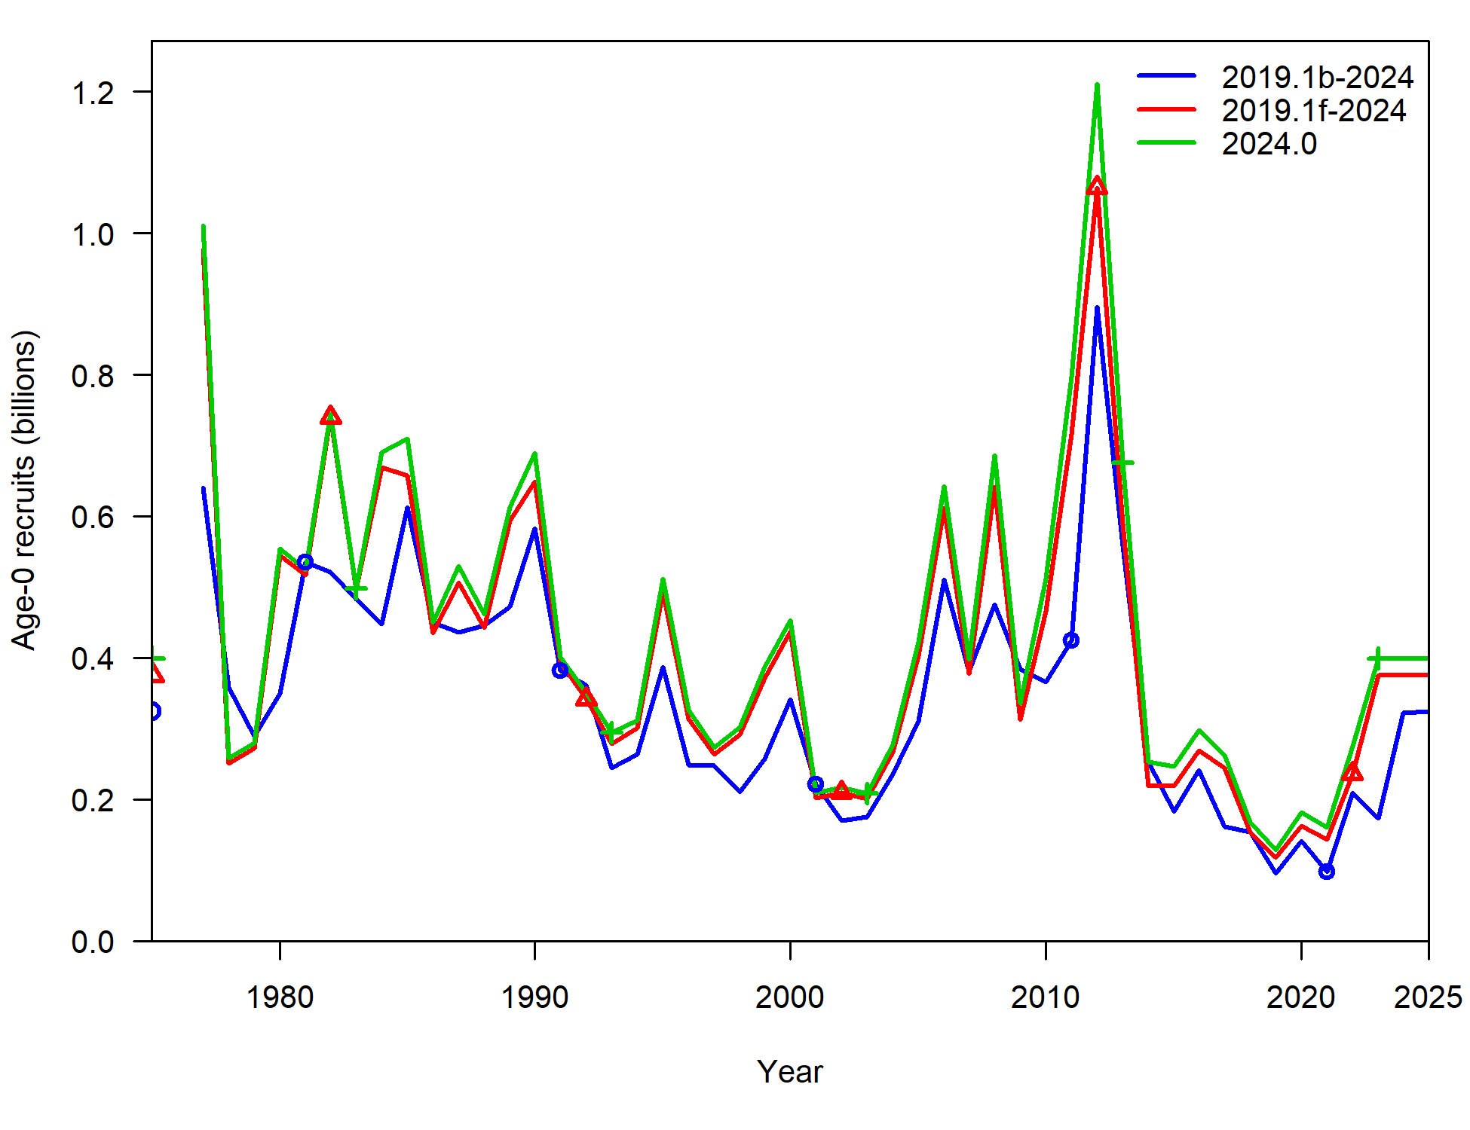
Trawl survey selectivity
New model: 2024.0

Slide 35
Summary of Recommendations
Recommended model 2024.0
Corrects a number of errors and better aligns with other cod assessments (2019.1c)
Updates ageing error (2019.1d)
Simplifies complexities in data inputs and data structure (2019.1e.5cm)
Corrects maturity transpose error (2019.1f)
Simplifies estimation of trawl survey selectivity (2024.0)

Slide 36
Apportionment investigation
Reminder: AFSC longline survey (LLS) used in assessment as additional pop’n index, but not used in apportionment
And, includes an environmental link, where in warmer temps at depth cod move deeper and are more available to the survey than in colder years
Including it in apportionment is a longstanding SSC request
Other, ‘tracked’, pop’n indices include IPHC FISS and ADF&G large mesh trawl survey

Slide 37
Apportionment investigation
Here, look at including LLS into rema as an additional index to be used for apportionment
Step-wise approach:
First, look at AIC ‘preferred’ model when it comes to Process Error (PE) and index scaling (q) parameters
Next, with ‘preferred’ models investigate estimating additional observation error

Slide 38
Apport inv: Step 1
4 cases: factorial design of global (1), or regional (3) PE and q parameters
PE = 1, q = 1
PE = 3, q = 1
PE = 1, q = 3
PE = 3, q = 3

Slide 39
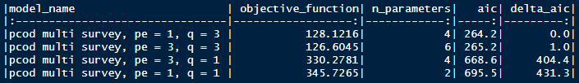
Apport inv: Step 1
AIC suggests that regional scaling parameters q are supported (and most influential)
Whether PE = 1 or 3, no real difference in model
So, to cover our bases, select PE = 1, q= 3 and PE = 3, q = 3 for additional uncertainty analysis

Slide 40
Apport inv: Step 2
6 cases: factorial design of 2 PE-q cases from step 1 x 3 uncertainty cases:
Additional uncertainty in trawl survey
Additional uncertainty in longline survey
Additional uncertainty in both

Slide 41
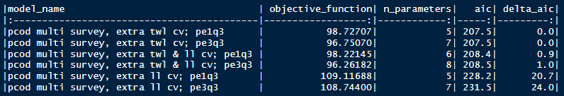
Apport inv: Step 2
Results in 4 models that are essentially the same, in terms of AIC
Preferred model:
For PE-q, argue for parsimony: select PE = 1 and q = 3 case
For additional uncertainty, argue:
When adding trawl survey uncertainty, largest decline in AIC (and is significant)
Acknowledge that these don’t include environmental link for longline survey, so, there’s a sources of uncertainty that we haven’t yet explained in this model
So, select additional uncertainty in both

Slide 42
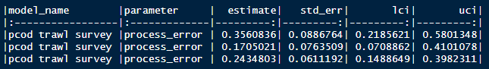
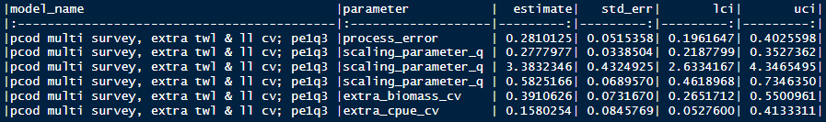
Apport inv: Comparisons
Compare between:
Base model: trawl survey only (pcod trawl survey)
Preferred model: both trawl and longline survey with 1 process error parameter, 3 scalar parameters, and additional uncertainty estimated for both surveys

Slide 43
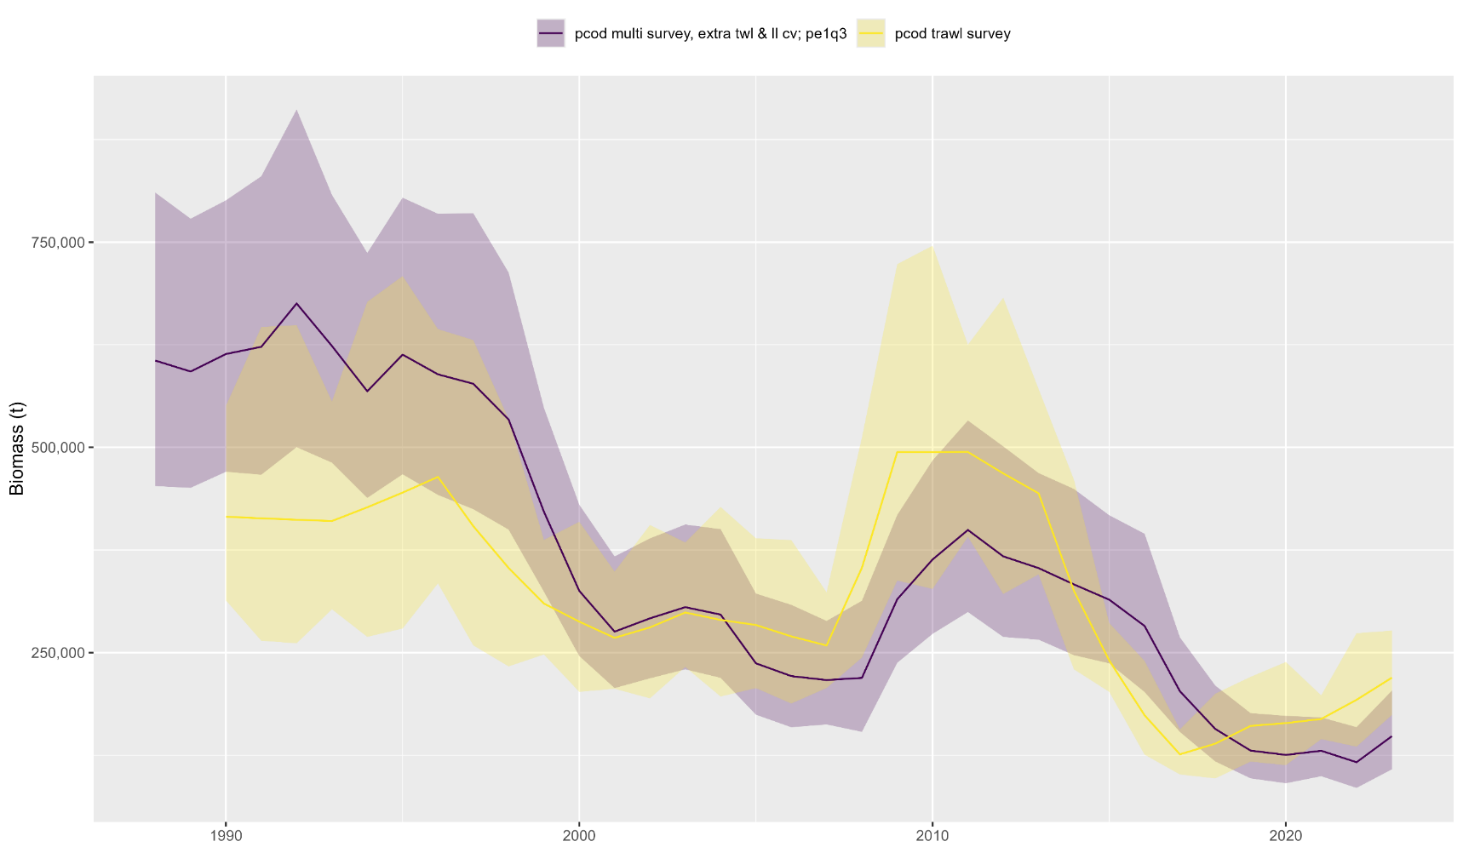
Apport inv: Comparisons
Estimated biomass:

Slide 44
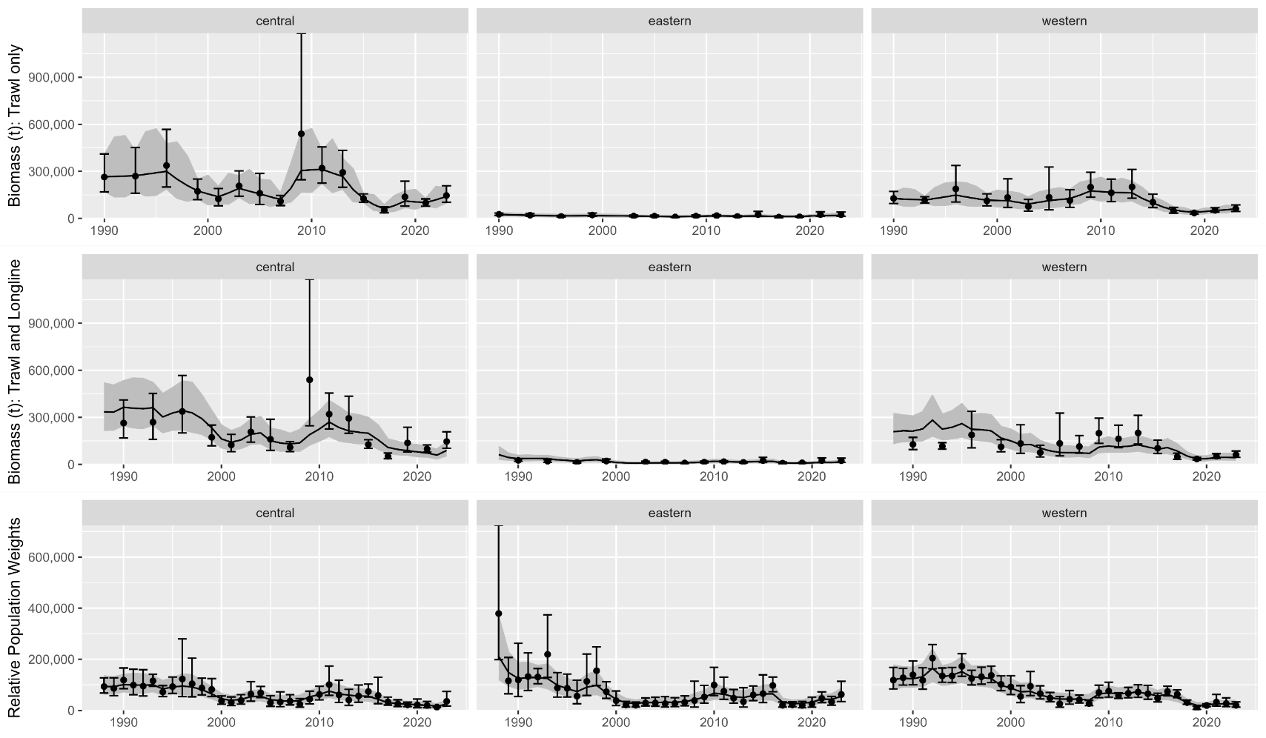
Apport inv: Comparisons
Data fits:

Slide 45
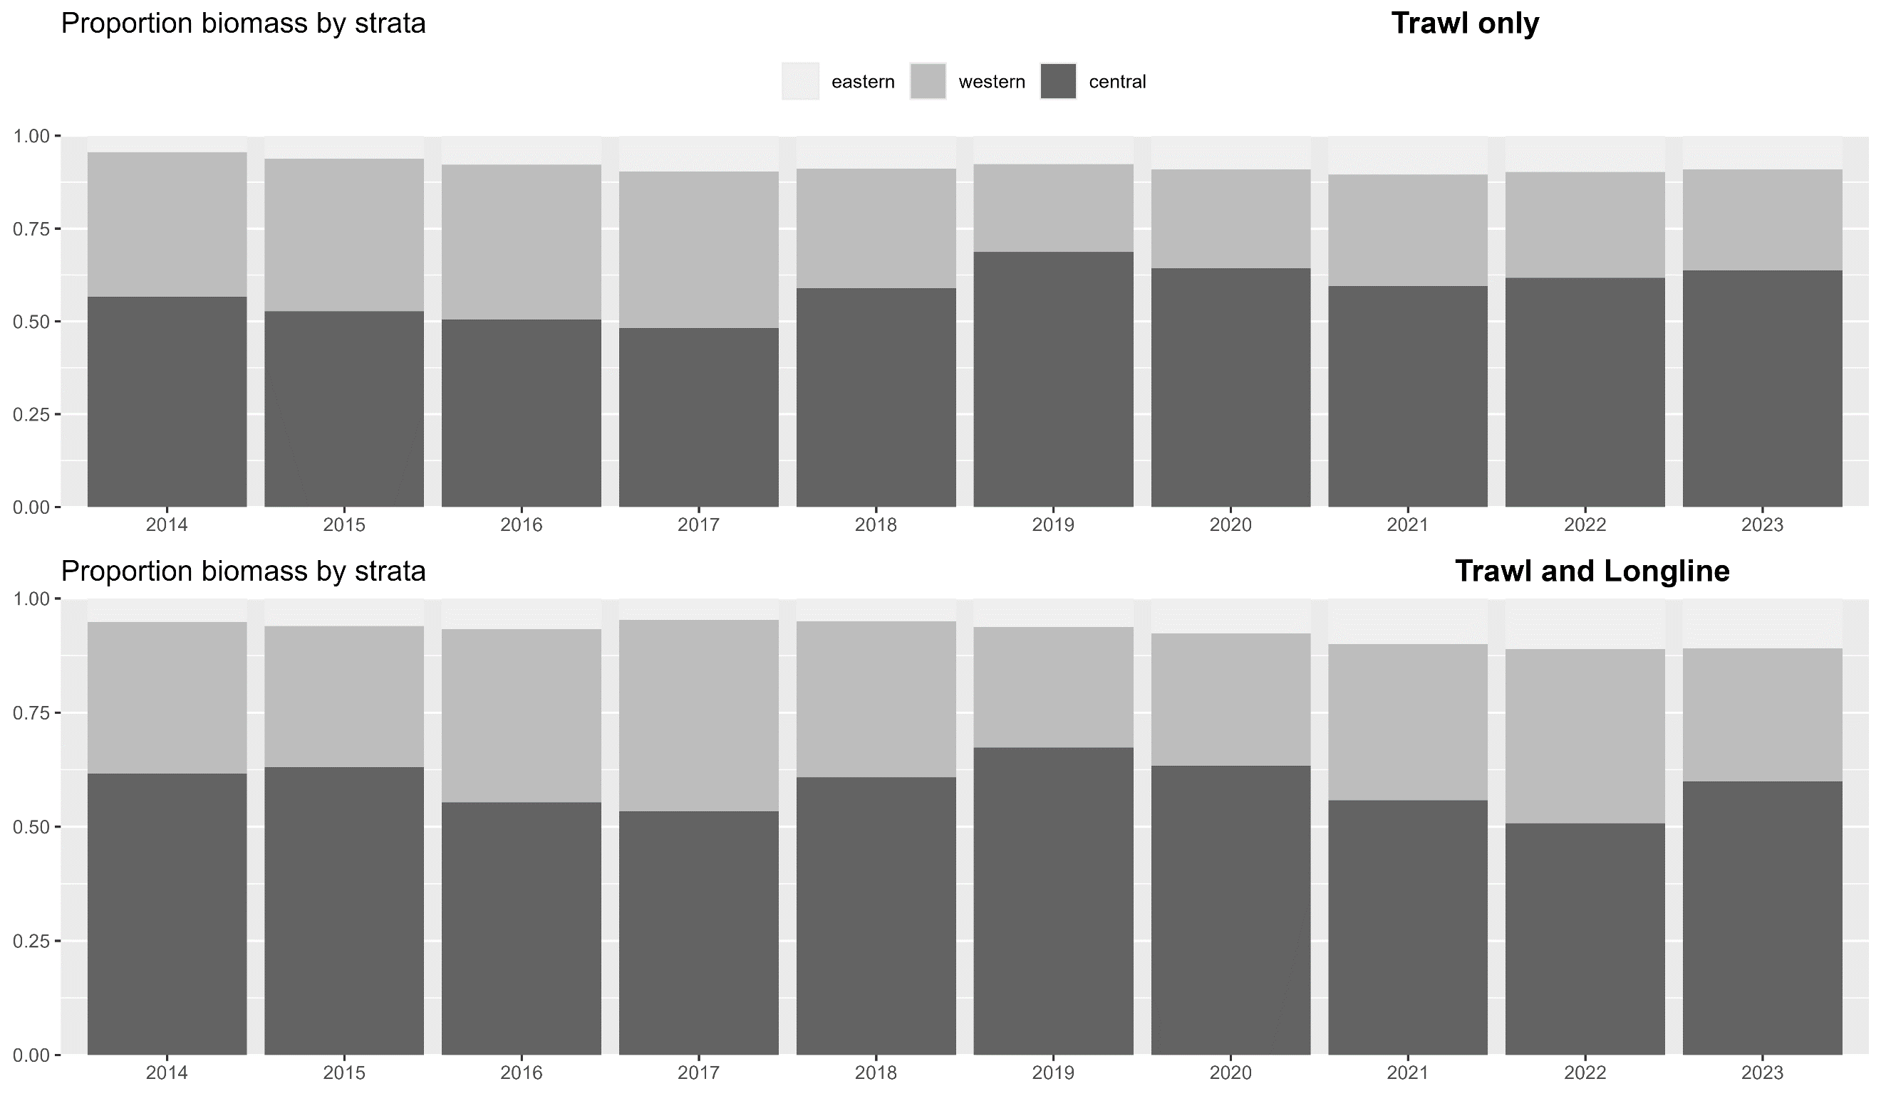
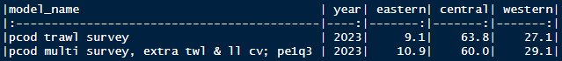
Apport inv: Comparisons
Apportionment:

Slide 46
Apport inv: Discussion
Recommendation: use rema with additional index with preferred parameterization
Makes apportionment consistent with data used in assessment
But, it will likely result in more variable apportionment compared to using only trawl survey
Next steps:
Working on environmental index, will be looking towards region indices to potentially be used in apportionment
Survey timing is slightly different in each region, whether/if this results in different environmental conditions by region remains to be seen
Currently rema not developed to include environmental index

Slide 47
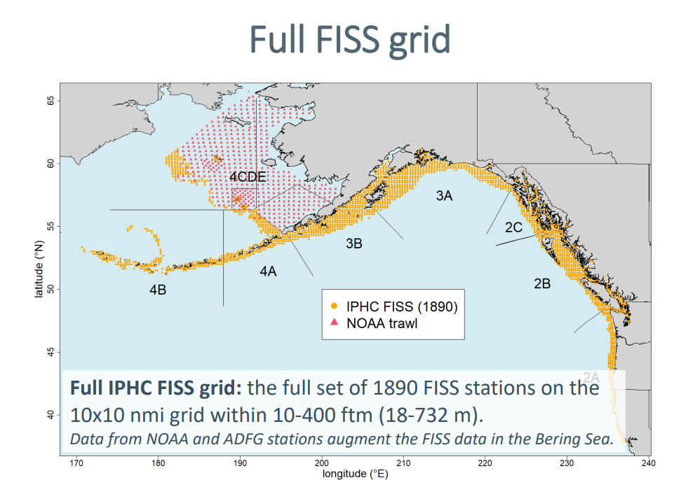
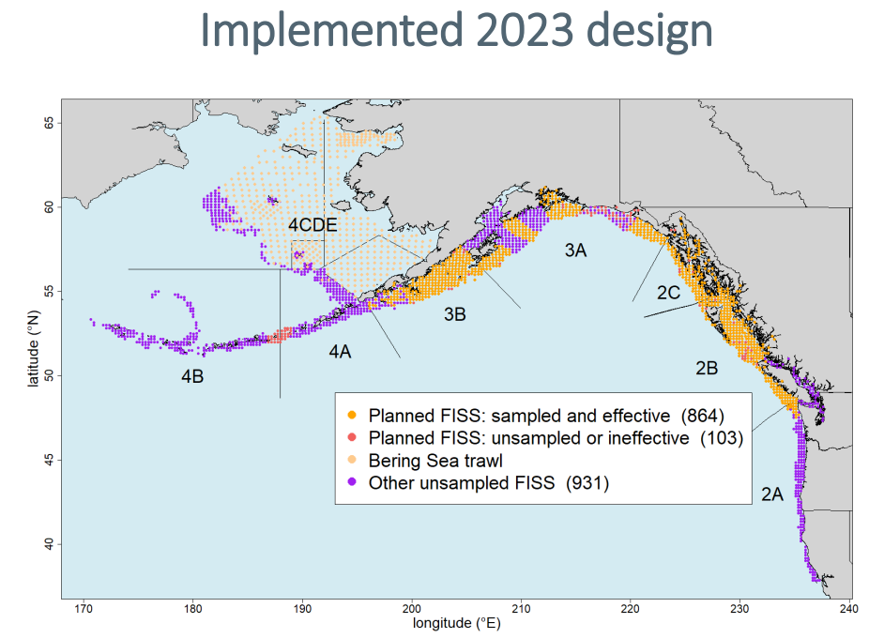
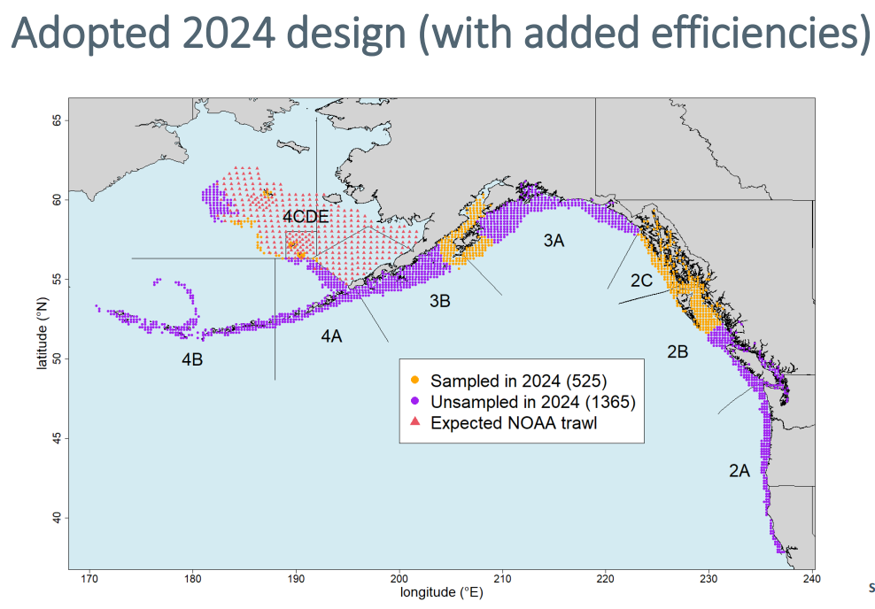
Apport inv: Discussion
Other indices: IPHC FISS
Has always been a promising additional index for apportionment, but, recent developments have made implementation questionable for Pacific cod
Recommend: not consider FISS as viable alternative index for Pacific cod until stations randomly subsampled or full FISS design is implemented

Slide 48
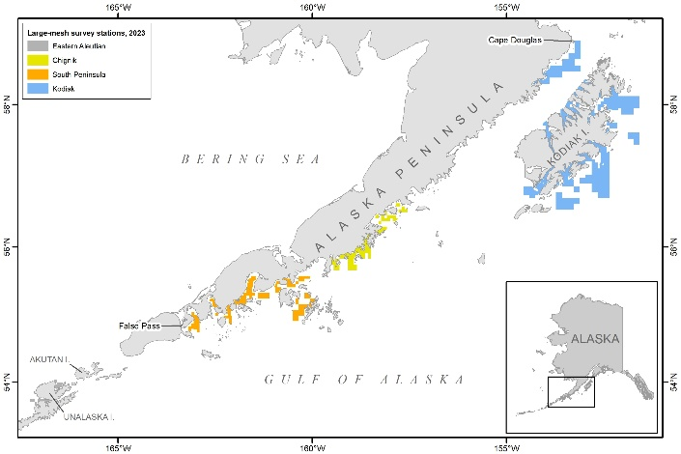
Apport inv: Discussion
Other indices: ADF&G large mesh survey
Rub here: only samples western and central gulf
But, if there is additional information about trend in these two subregions, could possibly use it in rema
However, rema currently not capable of including third index
Recommend: for now continue to track ADF&G survey in assessment, but since we have 2 indices in rema that have good spatial coverage, not spend time yet developing this as an additional index

Slide 49
Age comp inv
Fishery data:
Currently computed for males/females, then combined (and, excludes unsexed data)
But, length comps have never been computed this way, have always combined sex data prior to expansion
Computed with FSA package, rather than the observed ALK
Idea: randomly assigns lengths to ages with an ALK approach
But, can obtain ages that weren’t observed, particularly because
Requires: must define smallest lengths in each year as age-1
Propose:
Combine age/length data across sexes pre-expansion
Use year-specific ALK & remove age-1 assignment (stop using FSA package)
Use proposed length comp expansion
Why? You’ll see…

Slide 50
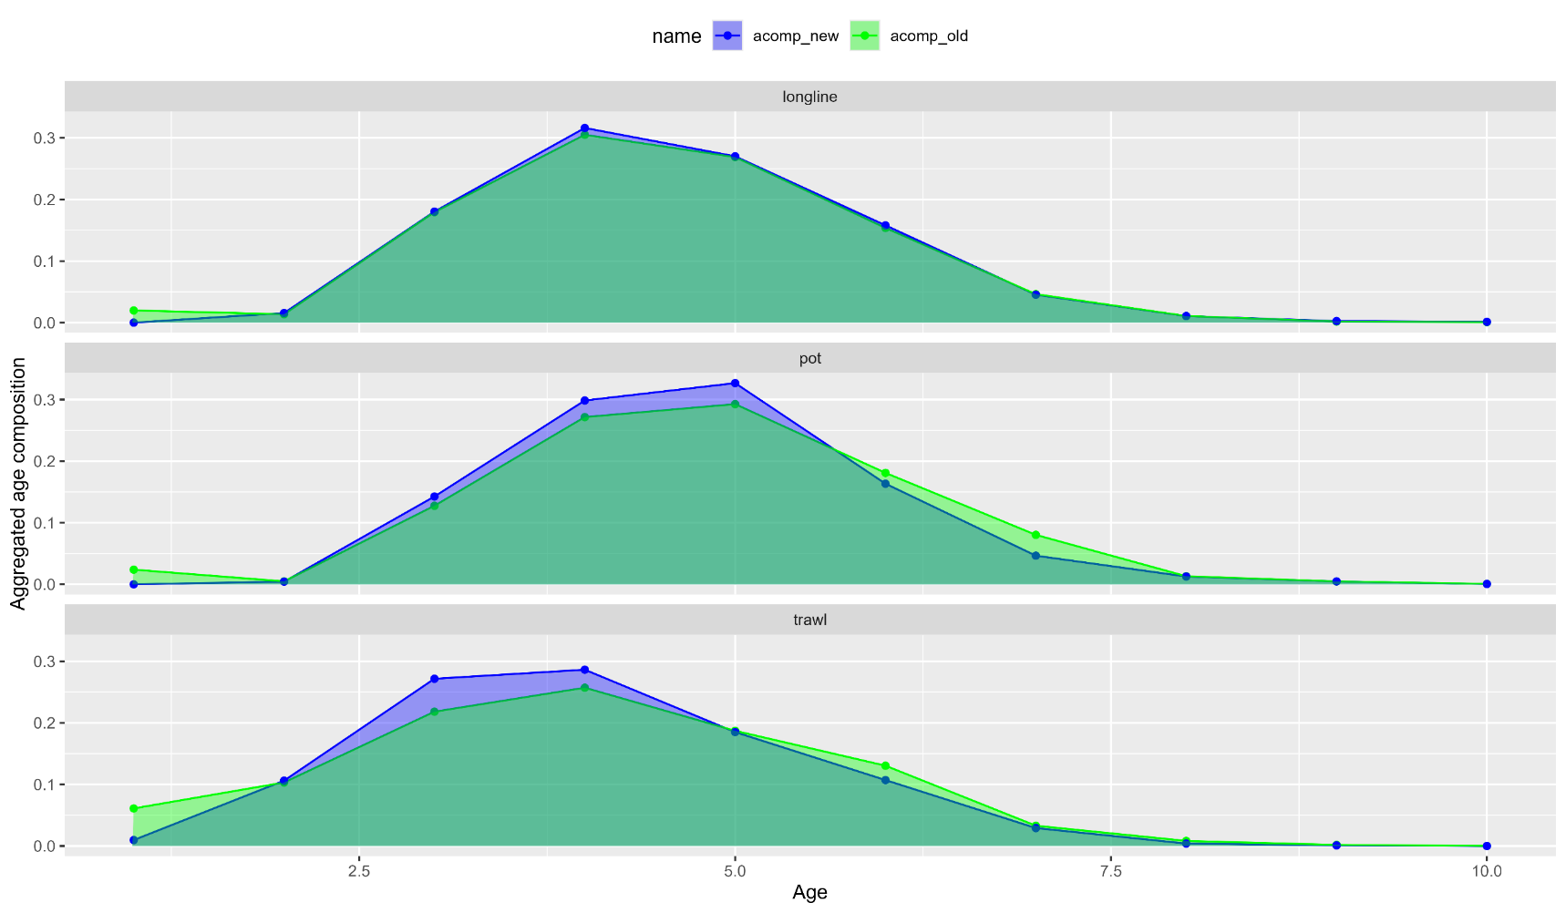
Age comp inv
Fishery data: aggregated plots

Slide 51
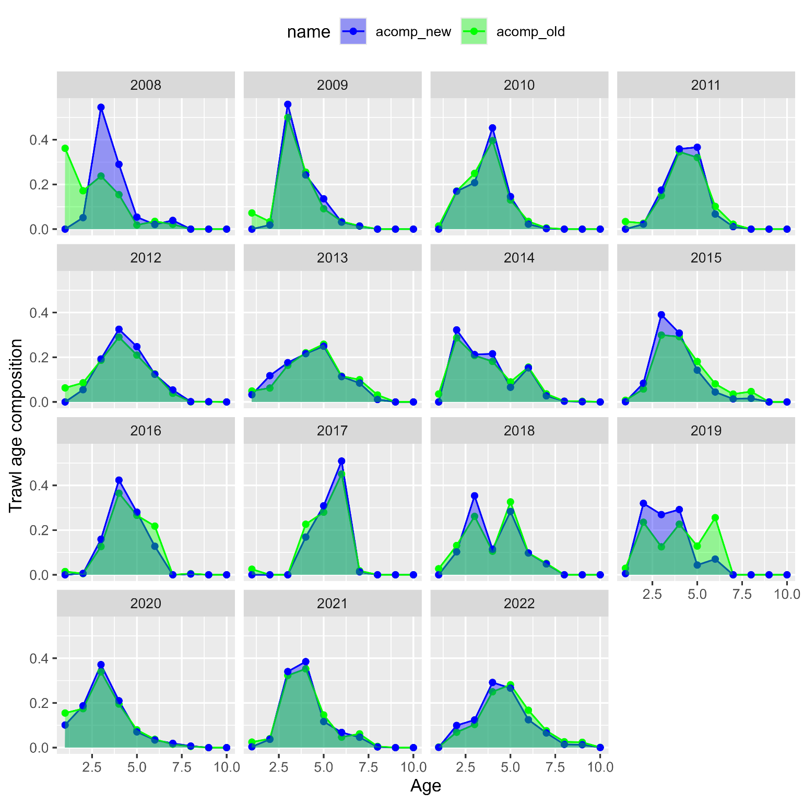
Age comp inv
Trawl fishery:

Slide 52
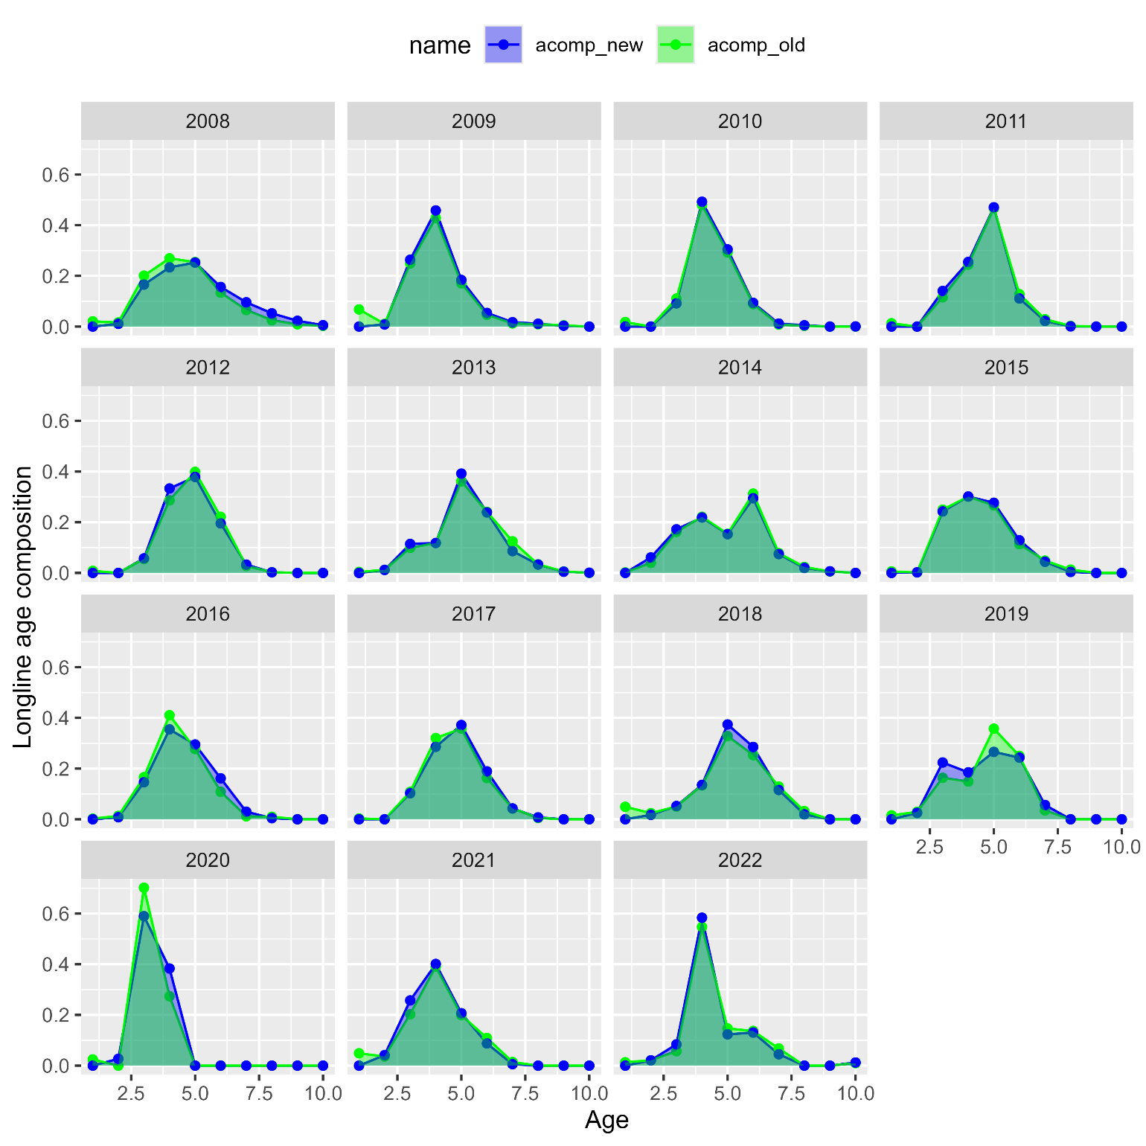
Age comp inv
Longline fishery:

Slide 53
Age comp inv
Pot fishery:

Slide 54
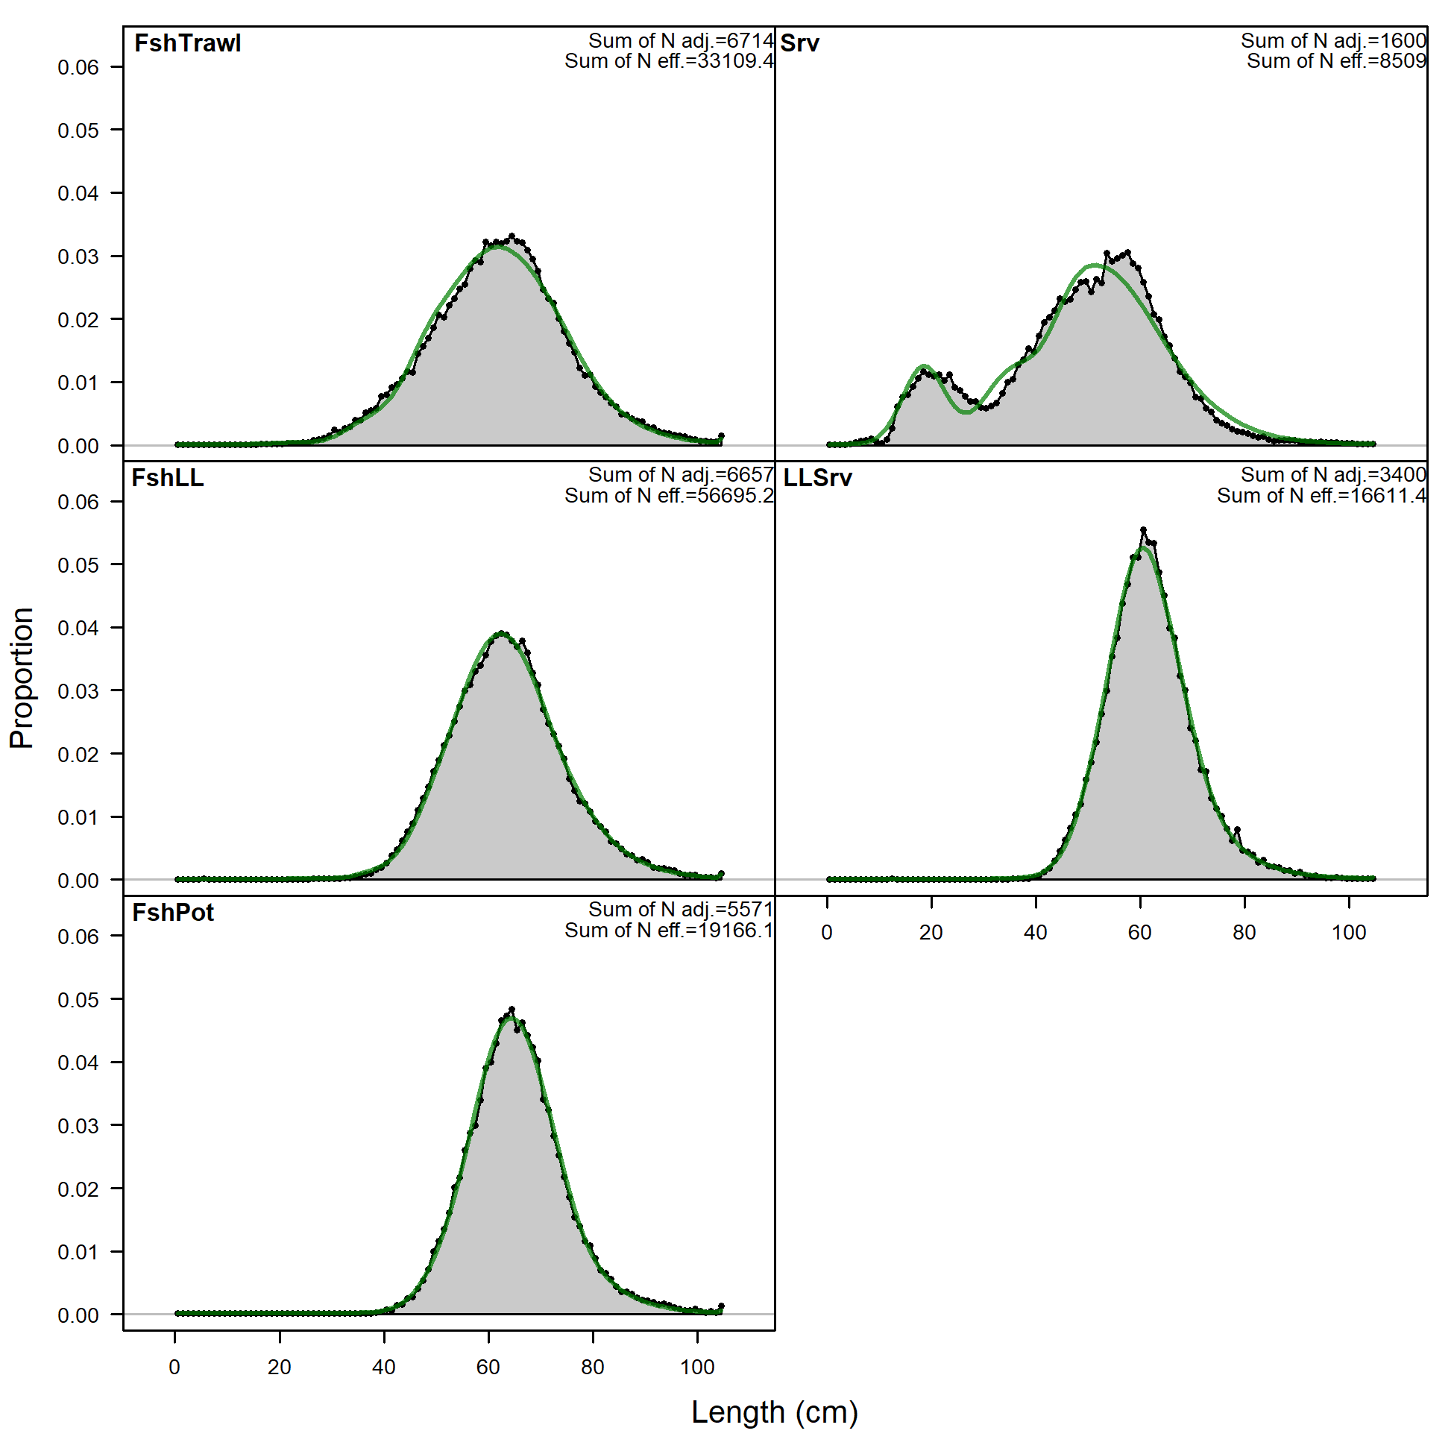
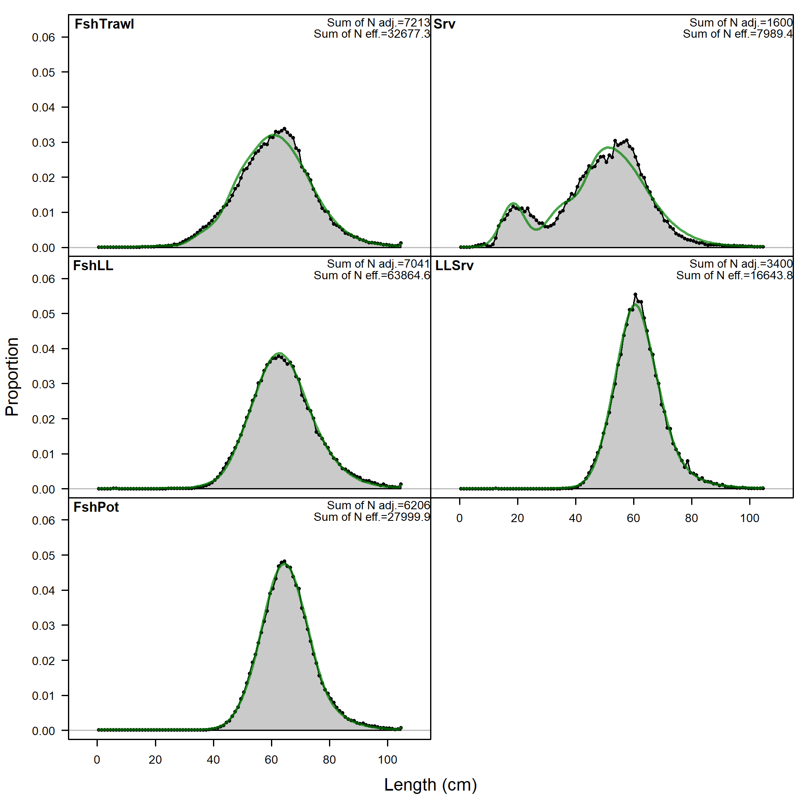
2019.1d
2019.1e

Slide 55
